Slide 1
CS301 – Data Structures
Lecture No. 26
Data Structures Lecture No. 26
Reading Material
Data Structures and Algorithm Analysis in C++
Chapter. 4
4.4.2
Summary
•
•
Hoffman Encoding
Mathematical Properties of Binary Trees
Huffman Encoding
We will continue our discussion on the Huffman encoding in this lecture. In the previous lecture, we talked about the situation where the data structure binary tree was built. Huffman encoding is used in data compression. Compression technique is employed while transferring the data. Suppose there is a word-document (text file) that we want to send on the network. If the file is, say, of one MB, there will be a lot of time required to send this file. However, in case of reduction of size by half through compression, the network transmission time also get halved. After this example, it will be quite easy to understand the Hoffman encoding to compress a text file.
We know that Huffman code is a method for the compression of standard text documents. It makes use of a binary tree to develop codes of varying lengths for the letters used in the original message. Huffman code is also a part of the JPEG image compression scheme. David Huffman introduced this algorithm in the year 1952 as part of a course assignment at MIT.
In the previous lecture, we had started discussing a simple example to understand Huffman encoding. In that example, we were encoding the 32-character phrase: "traversing threaded binary trees". If this phrase were sent as a message in a network using standard 8-bit ASCII codes, we would have to send 8*32= 256 bits. However, the Huffman algorithm can help cut down the size of the message to 116 bits.
In the Huffman encoding, following steps are involved:
List all the letters used, including the "space" character, along with the frequency with which they occur in the message.
Consider each of these (character, frequency) pairs as nodes; these are actually
leaf nodes, as we will see later.
Pick two nodes with the lowest frequency. If there is a tie, pick randomly amongst those with equal frequencies
Make a new node out of these two and develop two nodes as its children.
This new node is assigned the sum of the frequencies of its children.
Continue the process of combining the two nodes of lowest frequency till the time, only one node, the root, is left.

Slide 2
CS301 – Data Structures
Lecture No. 26
In the first step, we make a list of all letters (characters) including space and end line character and find out the number of occurrences of each letter/character. For example we ascertain how many times the letter ‘a’ is found in the file and how many times ‘b’
occurs and so on. Thus we find the number of occurrences (i.e. frequency) of each letter in the text file.
In the step 2, we consider the pair (i.e. letter and its frequency) as a node. We will
consider these as leaf nodes. Afterwards, we pick two nodes with the lowest frequency in the list. If there are more than one pairs of same frequency, we will choose a pair randomly amongst those with equal frequencies.
Suppose, in a file, the letter ‘a’ occurs 50 times and ‘b’ and ‘c’ five times each. Here, ‘b’ and ‘c’ have the lowest frequency. We will take these two letters as leaf nodes and
build the tree from these ones. As fourth step states, we make a new node as the parent of these two nodes. The ‘b’ and ‘c’ are its children. In the fifth step, we assign
to this new node the frequency equal to the sum of the frequencies of its children. Thus a three-node tree comes into existence. This is shown in the following figure.
10
a, 5
b, 5
Fig 26.1:
We continue this process of combining the two nodes of lowest frequency till the time, only one node i.e. the root is left.
Now we come back to our example. In this example, there is a text string as written below.
traversing threaded binary trees
The size of this character string is 33 (it includes 3 space characters and one new line character). In the first step, we perform the counting of different characters in the string manually. We do not assign a fake or zero frequency to a letter that is not present in the string. A programmer may be concerned only with the characters/letters that are present in the text. We see that the letters and their frequencies in the above text is as given below.
Character | frequency | character | frequency
NL | 1 | I | 2
SP | 3 | n | 2
A | 3 | r | 5
B | 1 | s | 2
D | 2 | t | 3
E | 5 | v | 3
G | 1 | y | 1
H | 1
Table 1: Frequency table

Slide 3
CS301 – Data Structures
Lecture No. 26
In the second step, we make nodes of these pairs of letters and frequencies. The following figure (fig 26.2) depicts the letters as nodes. We have written the frequency of each letter with the node. The nodes have been categorized with respect to the
frequencies for simplicity. We are going to build the tree from downside i.e. from the lowest frequency.
Now according to third step, two nodes of lowest frequency are picked up. We see
that nodes NL, b, g, h, v and y have the frequency 1. We randomly choose the nodes v and y. now, as the fourth step, we make a new node and join the leaf nodes v and y to it as its children. We assign the frequency to this new (parent) node equal to the sum of the frequencies of its children i.e. v and y. Thus in the fifth step; the frequency of this new node is 2. We have written no letter in this node as shown in the figure below.
2 is equal to sum
of the frequencies of the two children nodes.
a 3
t 3
e 5
r 5
d 2
i n
2 2
s 2
2
SP 3
NL 1
b g
1 1
h 1
v 1
y 1
Fig 26.2: Nodes with their respective frequencies
Now we continue this process with other nodes. Now we join the nodes g and h as children of a new node. The frequency of this node is 2 i.e. the sum of frequencies of g and h. After this, we join the nodes NL and b. This also makes a new node of frequency 2. Thus the nodes having frequency 1 have joined to the respective parent nodes. This process is shown in the following figure (Fig 26.3).

Slide 4
CS301 – Data Structures
Lecture No. 26
a 3
t 3
e 5
r 5
d 2
i n
2 2
s 2
2
2
2
SP 3
NL b g h
1 1 1 1
v 1
y 1
Fig 26.3: joining leaf nodes to create new nodes
Now we come to the nodes with a frequency 2. Here we join the pair of nodes d and i and also the pair n and s. Resultantly, the two nodes coming into being after joining have the frequency 4. This frequency is the sum of the frequencies of their children. Now, we will bring the nodes, a and t together. The parent node of a and t has the frequency 6 i.e. the sum of a and t. These new nodes are shown in the following figure.
6
a 3
t 3
4
4
4
e 5
r 5
5
d 2
i n
2 2
s 2
2
2
2
SP 3
NL b g h
1 1 1 1
v 1
y 1
Fig 26.4: joining different nodes to create new nodes
Now we consider these new nodes as inner nodes and build the tree upward towards the root. Now we take the node SP and join it with the node that is the parent of v and
y. The resultant node has frequency 5 as the frequencies of its children are 2 and 5
respectively. Now we join these nodes of higher frequencies. In other words, the node r is joined with the newly created node of frequency 5 that is on the left side of node r in the figure 26.5. Thus a new node of frequency 10 is created. We join the node e and the node of frequency 4 on its right side. Resultantly, a new node of frequency 9 comes into existence. Then we join the nodes having frequency 4 and create a new

Slide 5
CS301 – Data Structures Lecture No. 26
node of frequency 8. The following figure shows the nodes created so far.
6
8
9
10
a 3
t 3
4
4
4
e 5
r 5
5
d 2
i n
2 2
s 2
2
2
2
SP 3
NL b g h
1 1 1 1
v 1
y 1
Fig 26.5: joining of nodes to build a tree
Now we will join the nodes of frequency 6 and 8 to create the node of frequency 14 and join the nodes of frequency of 9 and 10 to develop a new node of frequency of 19. At the end, we make the root node with the frequency 33 and it comprises nodes of frequency 14 and 19. Thus the tree is completed and shown in the following figure.
Page 300 of 505

Slide 6
CS301 – Data Structures
Lecture No. 26
33
14
19
9
10
a 3
6
8
t 4 4 4
3
e 5
r 5
5
d 2
i n
2 2
s 2
2 2 2
SP 3
NL b g h
1 1 1 1
v 1
y 1
Fig 26.6: Hoffman encoding tree
Now we will perform other steps of Hoffman encoding and develop character- encoding scheme needed for data compression.
To go ahead, we have to do the following steps.
Start at the root. Assign 0 to left branch and 1 to the right branch.
Repeat the process down the left and right subtrees.
To get the code for a character, traverse the tree from the root to the character leaf node and read off the 0 and 1 along the path.
We start from the root node of the tree and assign the value 0 to the left branch and 1 to the right branch. Afterwards, we repeat this value assigning at nodes in left and right subtrees. Thus all the paths have a value 0 or 1 as shown in the following figure. We will develop the code with the help of these path values.

Slide 7
CS301 – Data Structures
Lecture No. 26
33
0
1
14
19
0
1
0
1
6
1
8
9
10
1
0
0
1
0
1
0
a 3
t 3
4
1
4
4
e 5
r 5
5
0
0
i n
2 2
1
s 2
0
1
0
1
d 2
2 2
0 1 0 1
2
SP 3
NL b g h
1 1 1 1
0
v 1
1
y 1
Fig 26.7: Hoffman encoding tree with path values
In the last step, we get the code for the characters. To get the code for a character, there is need of traversing the tree from the root to the character leaf node and read off the 0 and 1 along the path. We start from the root and go to the letter of leaf node following the edges. 0 and 1 are written down in the order in which they come in this traversal to leaf node. For example, we want the code of letter d. To reach d from the root; we have to go through the nodes of frequency 14. This path has value 0. Here, 0 will be the first digit in the code of d. From 14, we go to node of frequency 8. This link (from 14 to 8) has value 1. Thus the second digit in code is 1. From node of frequency 8, we go to node of frequency 4 to its left side. This side has value 0, meaning that 0 is the third digit of code. From 4, we finally go to d and in this link we get the value 0. Thus we see that to reach at d from the root, we have gone through the branches 0, 1, 0 and 0. Thus, the code of letter d is 0100. Similarly the code of i is 0101. The same way, we find the code for each letter in the tree. The following table shows the letters and their correspondent codes.
character | code | character | code
NL | 10000 | i | 0101
SP | 1111 | n | 0110
a | 000 | r | 110

Slide 8
CS301 – Data Structures
Lecture No. 26
b | 10001 | s | 0111
d | 0100 | t | 001
e | 101 | v | 11100
g | 10010 | y | 11101
h | 10011
Table 2: Hoffman code table
We know that every character is stored in the computer in binary format. Each character has a code, called ASCII code. The ASCII code of a character consists of ones and zeros i.e. it is in binary form. ASCII code is of eight bits. Normally, we remember the decimal value of the characters. For example, letter ‘A’ has decimal value 65. We can easily convert the decimal value into binary one in bit pattern. We need not to remember these values. ASCII value of any character can be found from the ASCII table. The ASCII code of each character is represented in eight bits with different bit patterns.
Here in the example, we assign a code of our own (i.e. Hoffman code) to the letters that are in the message text. This code also consists of ones and zeros. The above
table shows the characters and their Hoffman code. Now we come back to the message text from which we developed the tree and assigned codes to the letters in
the text.
Look at the table (Table 2) shown above. Here we notice that the code of letters is of variable length. We see that letters with higher frequency have shorter code. There are some codes with a length five that are the codes of NL, b, g, h, v and y. Similarly we see that the letters SP, d, i, n and s have codes of length four. The codes of the remaining letters have length three. If we look at the frequency table (Table 1) of these letters, we see that the letters with some higher frequency like a, e, r, and t, have the code of shorter length, whereas the letters of lower frequency (like NL, b, g, h, v and y) have codes of larger length.
We see in the table of the Hoffman codes of the letters that there will be need of 5, 4
or in some codes only 3 bits to represent a character, whereas in ASCII code, we need 8 bits for each character. Now we replace the letters in the text message with these codes. In the code format i.e. in the form of ones and zeros, the message becomes as under.
Our original message was
traversing threaded binary trees The encoded form of the message is as under
t r a v e r s i n g t
00111000011100101110011101010110100101111001
100111101010000100101010011111000101010110000
110111011111001110101101011110000
We see that there are only ones and zeros in the code of message. Some letters have been shown with their corresponding code. The first three bits 001 are for letter ‘t’. The next three bits 110 are for letter ‘r’. After this the letter ‘a’ has three bits i.e. 000.

Slide 9
CS301 – Data Structures Lecture No. 26
Next to it is the letter ‘v’ that has five bits. These bits are 11100 (shaded in the figure). Similarly we have replaced all the letters of the message with their corresponding Hoffman code. The encoded message is shown above.
Let’s compare this Hoffman encoded message with the encoding of message with
ASCII code. The ASCII code encoding means that if we have encoded this message with 8 bits per character, the total length of message would be 264. As there are 33 characters, so the total length is 33 x 8 = 264. But in the Hoffman encoded message (written in above table), there are only 120 bits. This number of bits is 54% less than the number of bits in ASCII encoding form. Thus we can send the message with almost half of the original length to a receiver.
Here the Hoffman encoding process comes to an end. In this process, we took a message, did the frequency count of its characters and built a tree from these
frequencies. From this tree, we made codes of letters consisting of ones and zeros only. Then with the help of these codes, we did the data compression. In this process
we saw that less data is required for the same message.
Now an important thing to be noted is regarding the tree building. We have built the tree with our choices of nodes with same and different frequencies. Now if we have chosen the nodes to join in different way, the tree built would be in a different form. This results in the different Hoffman code for the letters. These will be in ones and zeros but with different pattern. Thus the encoded message would have different codes for the letters. Now the question arises how does the receiver come to know that what code is used for what letter? The answer is very simple that the sender has to tell the receiver that he is using such codes for letters. One way to tackle this problem is that the sender sends the tree built through the use of frequencies, to the receiver to decode the message. The receiver keeps a copy of this tree. Afterwards, when the sender sends a message, the receiver will match it with respect to bit pattern with the tree to see that what letter the sender has sent. The receiver will find the letter for the first 2, 3, 4 or what numbers of bits match to a letter that it has in the tree as the receiver also has a copy of the tree. We know that a tree has a root, inner nodes and leaf node(s). The leaf node is a node whose left and right links is NULL. An inner node has a left or right or both children. Now consider that the receiver has the same tree data structure that the sender used to construct the codes. The sender has sent the message that we have discussed above. The sender sends the 122 bits encoded message to the receiver. The receiver will take the first bit of message and being on the root of the tree, it will decide that on what side this bit will go. If the bit is zero, it will go to the left of the root. However, if the bit is one, it will go to the right side of the root before reaching to the child node. The next bit will go to the next level of the tree to the left or right side depending on zero or one. Thus the traversal will go one level down on receiving a bit. If we (the receiver) are on a path of the tree where the leaf node is at level 6, it cannot reach the leaf node unless the receiver receives 6 bits. We consider the case of letter ‘e’ whose code was of three bits. In this case, we go to the first level by first bit and the second bit takes us to the third level. Finally on reaching the third level with the third bit, we get the leaf node. We know that this node is letter ‘e’ as the sender has sent us (as receiver) the whole tree with the characters in the nodes. Thus after traversing the three bits, the receiver has confirmed that it has received the letter ‘e’. Now on receiving the fourth bit, the receiver will go back to the root and continue to choose the path i.e. on zero it will go to the left and on one it will go to right. This way, it will reach the leaf node. The character at that node will be the next character of the message. The bit pattern that was comprised of

Slide 10
CS301 – Data Structures Lecture No. 26
following these links in the tree is extracted from the message. On the next bit, the receiver again goes to the root node and the previous procedure is repeated to find the next character. This way, it decodes the whole message.
The compression is very useful technique especially for communication purposes.
Suppose that we have to send a file of one Mb. Here each line in the file can be compressed to 50 or 60 percent. Thus the file of one MB will be compressed to half MB and can be sent more easily.
There is one more thing about this tree. When we started to build the tree from leaf nodes i.e. bottom-up build of tree, we saw that there were choices for us to choose any
two leaf nodes to join. In our example, we chose them at random. The other way to do it is the priority queue. We have seen the example of bank simulation. There we used a priority queue for the events. We know that in a priority queue, the elements do not
follow the FIFO (first in first out) rule. But the elements have their position in the queue with respect to a priority. In the example of bank simulation, in the Event
Queue, we remove the element from the queue that was going to occur first in the future. We can use priority queue here in such a way that we put the letters in the queue with respect to their frequencies. We will put and remove letters from the
queue with respect to their frequency. In this priority queue, the character with lowest frequency is at the start of the queue. If two characters have the same frequency, these
will be one after the other in the queue. The character with the larger frequency will be in the last of the queue. Now we take two frequencies from the queue and join them to make a new node. Suppose that the nodes that we joined have frequency 1
and 2 respectively. So the frequency of the new node will be 3. We put this new node in the queue. It takes its position in the queue with respect to its frequency as we are using the priority queue. It is evident in procedure that we proceed to take two nodes
form the queue. These are removed and their parent node goes back to the queue with a new frequency. This procedure goes on till the time the queue is empty. The last
node that becomes in the queue in the result of this procedure is the root node. This root node has frequency 33 if we apply this procedure to our previous example.
Let’s talk about some general things related to Hoffman encoding. We use modems to connect to Internet. These modems do the compression. The modem has a compression feature. The modem has a chip that performs the task of compression.
When we give a sentence of say 80 characters to the modem to send, the modem makes a Hoffman encoded tree of these characters. Then it will make codes from this tree. We know that there is also a modem on the other end that will decode this
message. The sender modem will send the tree structure to the receiver. Now the sender modem will send the data in compressed form. The receiving modem will
decode this compressed data by using the Hoffman encoded tree. Now the question arises, will these codes be useful for other messages? In our example message the letter ‘y’ has lower frequency and code of five bits. It may happen that in some
messages ‘y’ has higher frequency, needing code of less number of bits. To solve this problem, the modems (sender and receiver) revise the codes after a certain time period
or after a particular number of bytes. In this revision, they build a new Hoffman tree and exchange it to use it for communication for the next time period or for the next fixed number of bytes.
There is some other compression techniques/algorithms for compression. The zip routines like winzip and the jpeg, mpeg and other image formatting routines use
different algorithms for compression. We will read the compression algorithm in detail in the course of Algorithms.

Slide 11
CS301 – Data Structures
Lecture No. 26
Mathematical Properties of Binary Trees
There are some mathematical properties of binary trees, which are actually theorems. We will not prove these here. Most of these properties will be studied in some other courses where we will prove them as theorem. Here we are going to talk about some properties, much needed in the next topic about trees.
The first property is that a binary tree of N internal nodes has N+1 external nodes. We
are familiar with the term binary tree and internal node. The term external node is a new one. To understand the external nodes, look at the following figure.
A
internal nodes: 9
external nodes: 10
B
C
internal node
D
E
F
G
E
F
external node
Fig 26.8: Tree with internal and external nodes
In this figure, the nodes with value i.e. A, B, C, D, E, F and G are the internal nodes. Note that the leaf nodes are also included in internal nodes. In the figure, we see that the right pointer of B is NULL. Similarly, the left pointer of D is NULL. The square nodes in the figure are the NULL nodes. There is no data in these nodes as these are NULL pointers. However these are the positions where the nodes can exist. These
square nodes are the external nodes. Now we see in the figure that the internal nodes (leaf nodes are also included) are 9 and the external nodes (NULL nodes indicated by squares) are 10 (i.e. 9 + 1). Hence it is the property that we have stated. We will see the usage of this property in the upcoming lectures.

Slide 12
CS301 – Data Structures
Lecture No. 27
Data Structures Lecture No. 27
Reading Material
Data Structures and Algorithm Analysis in C++
Chapter. 4
4.3
Summary
•
•
•
•
•
Properties of Binary Tree Threaded Binary Trees Adding Threads During Insert
Where is Inorder Successor? Inorder Traversal
Properties of Binary Tree
By the end of the last lecture, we were having a discussion about the properties of the binary trees. Let us recall, that I told you about a property of the binary trees regarding relationship between internal nodes and external nodes i.e. If the number of internal nodes is N, the number of external nodes will be N+1. Today I am going to discuss another property of the binary trees, which together with the previous lecture, will give us a start into a new topic. Let me have your attention to the second property of the binary trees.
Property
A binary tree with N internal nodes has 2N links, N-1 links to internal nodes and N+1 links to external nodes.
Please recall that the first property dealt with the relationship between internal and external nodes. This property is dealing with the relationship of links to the internal nodes.
Now, what is a link? As you might already have understood, a link is that line, which we draw between two nodes in a tree. Internally we use pointers in C++ to realize links. In pictorial sketches, however, we use a line to show a link between the two nodes. The property defines, that if you have a binary tree with Nodes, how many links, it will have between the internal nodes (remember, it includes the leaf nodes), and how many links it will have between the external nodes. We have not been showing any links between the external nodes in the diagrams. These are, in fact, null pointers. That means, these are the links, which we will show with the help of the square nodes. Let us see a binary tree, on the basis of which, we will further explore this property. In the following figure, the binary tree is shown again, which, in addition to the normal links between the internal nodes, also contains external nodes as squares and the external links as lines going to those squares.

Slide 13
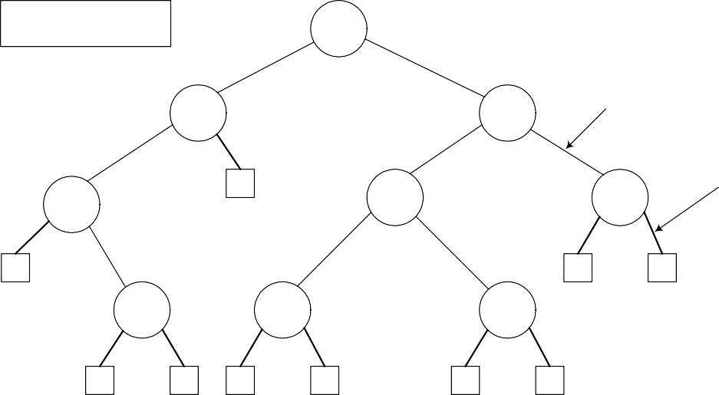
CS301 – Data Structures
Lecture No. 27
Internal links: 8
External links: 10
A
B
C
Internal link
D
E
F
external link
G
E
F
Fig 27.1
Now if you count the total number of links in the diagram between internal and external nodes, it will be 2N. Remember, we are talking about links and not nodes. In this tree, we have 9 nodes marked with capital letters, 8 internal links and 10 external links. Adding the both kinds of links, we get 18, which is exactly 2 x 9.
As discussed already that these properties are mathematical theorems and can therefore be proven mathematically. Let us now prove this property as to how do we get 2N links in a binary tree with N internal nodes.
Property
A binary tree with N internal nodes has 2N links, N-1 links to internal nodes and N+1 links to external nodes.
In every rooted tree, each node, except the root, has a unique parent.
Every link connects a node to its parents, so there are N-1 links connecting internal nodes.
Similarly each of the N+1 external nodes has one link to its parents.
Thus N-1+N+1=2N links.
In the previous lectures, I told you about the important property of the trees, that they contain only one link between the two nodes. I had also shown you some structures, which did not follow this property and I told you, that those were graphs.
Threaded Binary Trees
In many applications binary tree traversals are carried out repeatedly.
The overhead of stack operations during recursive calls can be costly.
The same would true if we use a non-recursive but stack-driven traversal procedure
It would be useful to modify the tree data structure which represents the binary

Slide 14
CS301 – Data Structures Lecture No. 27
tree so as to speed up, say, the inorder traversal process: make it "stack-free".
You must be remembering that there were four traversing methods of binary trees: preorder, inorder, postorder and levelorder. First three preorder, inorder and postorder were implemented using recursion. Those recursive routines were very small, 3 to 4 lines of code and they could be employed to traverse a tree of any size.
We also traversed BST in inorder to retrieve the information in sorted order. We
employed stacks in recursive implementations. Although, recursive routines are of few lines but when recursion is in action, recursive stack is formed that contains the function calls. We also explicitly used stack for inorder non-recursive traversal. When the calling pattern of recursive and non-recursive stack based routines were compared, the calling pattern of both of the routines were similar.
Suppose that we have a BST that is traversed again and again for some operations of find or print. Due to lot of recursive operations, the stack size keeps on growing. As a result, the performance is affected. To overcome this performance bottleneck, we can use non-recursive method but stack-driven traversal will again be an issue. The push and pop operations of stack for insertion and retrieval will again take time. So is there a way to do traversal without using a stack neither of implicit function call stack nor explicit. The same idea is presented in the last bullets above that leads to threaded binary trees:
It would be useful to modify the tree data structure which represents the binary tree so as to speed up, say, the inorder traversal process: make it "stack-free".
The idea in the above statement is to modify the tree data structure to speed up and make it stack-free. Now, we see what kind of modification is required in the binary trees.
Oddly, most of the pointer fields in our representation of binary trees are NULL!
Since every node (except the root) is pointed to, there are only N-1 non-NULL pointers out of a possible 2N (for an N node tree), so that N+1 pointers are NULL.
We know that all the leaf node pointers are NULL. Each node of the tree contains the data part, two pointer variables for left and right nodes links. But these pointer variables are used when the node has further child nodes. We know that in a binary tree the total number of links are 2N including both internal and external and the number of NULL pointers is N+1.

Slide 15
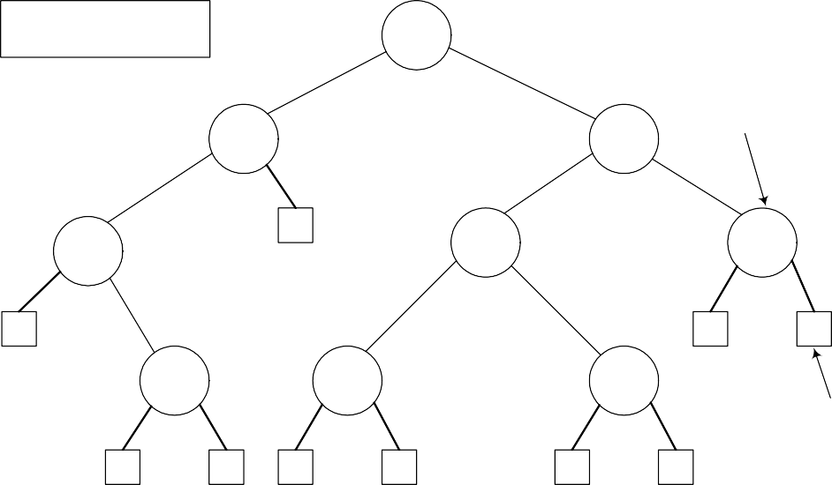
CS301 – Data Structures
Lecture No. 27
Internal nodes: 9
External nodes: 10
A
B
C
Internal node
D
E
F
G
E
F
external node
Fig 27.2
In the figure above, the tree is the same as shown in Fig 27.1. The square nodes shown in this figure are external nodes. Thinking in terms of pointers all the pointers of these nodes are NULL or in other words they are available to be used later. We recognize these nodes as leaf nodes. Besides that, what can we achieve using them is going to be covered in Threaded Binary Trees.
The threaded tree data structure will replace these NULL pointers with pointers to the inorder successor (predecessor) of a node as appropriate.
We are creating a new data structure inside the tree and when the tree will be
constructed, it will be called a threaded binary tree. The NULL pointers are replaced by the inorder successor or predecessor. That means while visiting a node, we can tell which nodes will be printed before and after that node.
We'll need to know whenever formerly NULL pointers have been replaced by non NULL pointers to successor/predecessor nodes, since otherwise there's no way to distinguish those pointers from the customary pointers to children.
This is an important point as we need to modify our previous logic of identifying leaf nodes. Previously the node with left and right nodes as NULL was considered as the leaf node but after this change the leaf node will contain pointers to predecessor and successor. So in order to identify that the pointers has been modified to point to their inorder successor and predecessor, two flags will be required in the node. One flag will be used for successor and other for predecessor. If both the pointers were NULL, left pointer variable will be used to point inorder predecessor, the flag for this will be turned on and the right pointer variable will be used to keep inorder successor and the flag will be turned on once the successor address is assigned.
Adding Threads During Insert

Slide 16
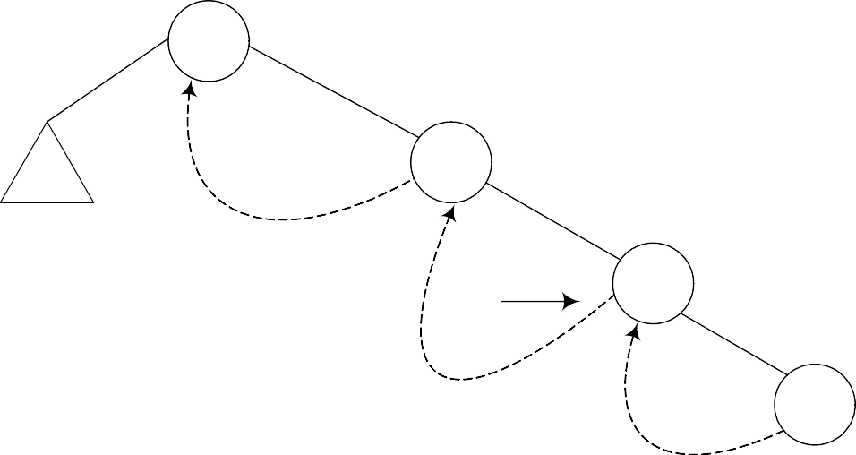
CS301 – Data Structures
Lecture No. 27
14
15
p
18
20
t
16
Fig 27.3
If we print the above tree in inorder we will get the following output: 14 15 18 20
In the above figure, the node 14 contains both left and right links. The left pointer is
pointing to a subtree while the right subtree is pointing to the node 15. The node 15’s right link is towards 18 but the left link is NULL but we have indicated it with a rounded dotted line towards 14. This indicates that the left pointer points to the predecessor of the node.
Below is the code snippet for this logic.
t->L = p->L; // copy the thread t->LTH = thread;
t->R = p; // *p is successor of *t
t->RTH = thread; p->L = t; // attach the new leaf p->LTH = child;
Let’s insert a new node in the tree shown in the above figure. The Fig 27.4 indicates this new insertion.

Slide 17
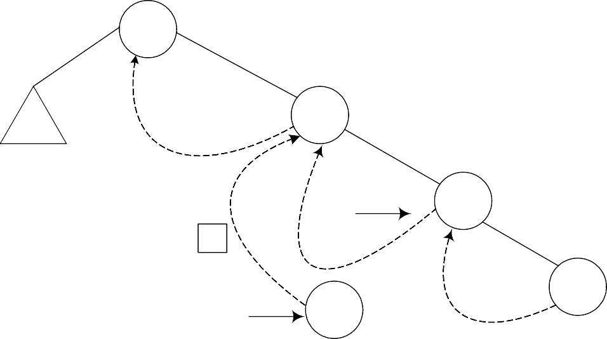
CS301 – Data Structures
Lecture No. 27
14
15
p
18
1
20
t
16
Fig 27.4
The new node 16 is shown in the tree. The left and right pointers of this new node are NULL. As node 16 has been created, it should be pointed to by some variable. The name of that variable is t. Next, we see the location in the tree where this new node with number 16 can be inserted. Clearly this will be after the node 15 but before node
18. As a first step to insert this node in the tree as the left child of the node 18, we did the following:
t->L = p->L; // copy the thread
t->LTH = thread;
t->R = p; // *p is successor of *t
t->RTH = thread;
p->L = t; // attach the new leaf
p->LTH = child;
As the current predecessor of node 18 is 15. After node 16 will be inserted in the tree, it will become the inorder predecessor of 18, therefore, in the first line of the code t-
>L = p->L, left pointer of node 18 (pointed to by pointer p) is assigned to the left pointer of node 16 (pointer to by pointer t).

Slide 18
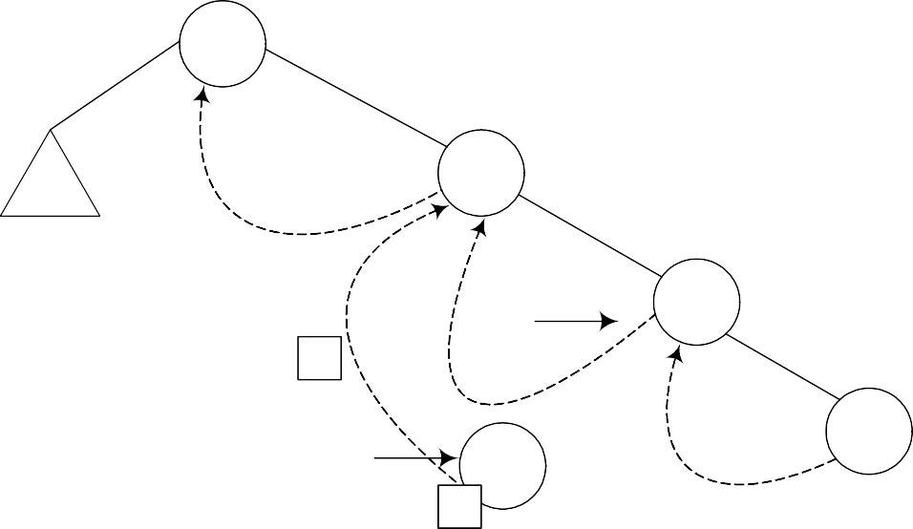
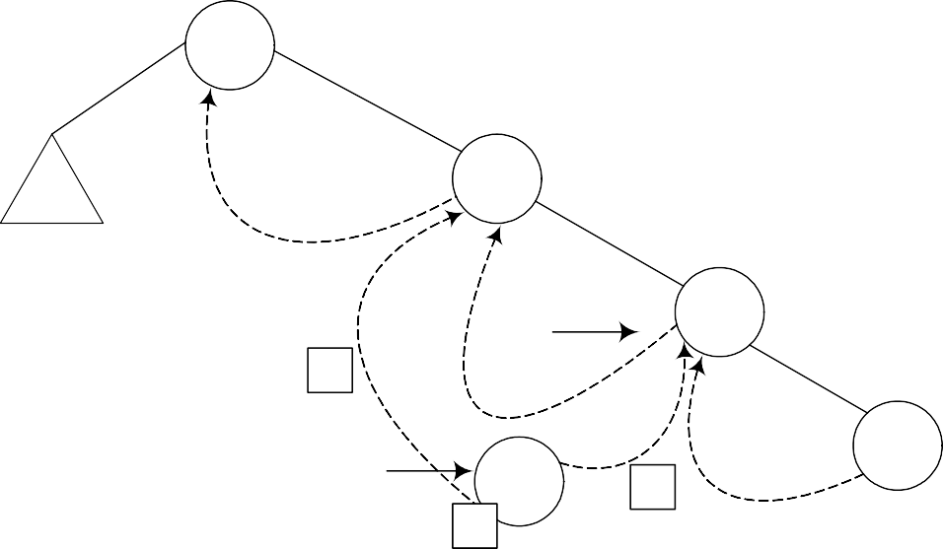
CS301 – Data Structures
Lecture No. 27
14
15
p
18
1
20
t
16
2
Fig 27.5
In the next line of code t->LTH = thread, the left flag is assigned a variable thread
that is used to indicate that it is on.
14
15
p
18
1
20
t 16
3
2
Fig 27.6
In the third line of code, t->R = p, 18 being the successor of node 18, its pointer p is assigned to the right pointer (t->R) of node 16.

Slide 19

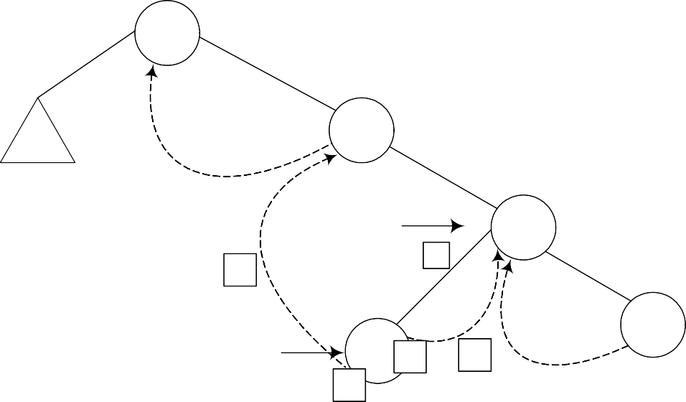
CS301 – Data Structures
Lecture No. 27
14
15
p
18
1
20
t
16 ₄
3
2
Fig 27.7
Next line, t->RTH = thread contains flag turning on code.
14
15
p
5
18
1
t
16 ₄
3
20
2
Fig 27.8
In the next line p->L = t, the node 16 is attached as the left child of the node 18.

Slide 20
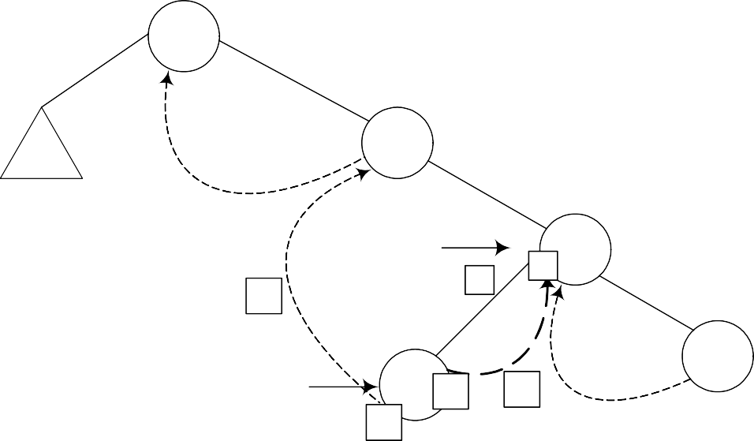
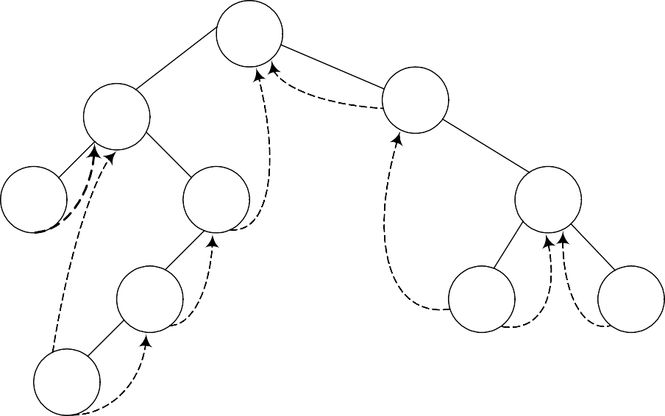
CS301 – Data Structures
Lecture No. 27
14
15
p
5
₆ 18
1
t
16 ₄
3
20
2
Fig 27.9
The flag is truned on in the last line, p->LTH = child.
If we insert few more nodes in the tree, we have the tree as given below:
14
4
15
3
9
18
7
16
20
5
Fig 27.10
Above given is a BST and you have seen many BSTs before, which are not thread binary trees. Without the threads, it is clear from the figure that there are number of links present in the tree that are NULL. We have converted the NULLs to threads in this tree.
Let’s do inorder non-recursive traversal of the tree. We started at 14 then following the left link came to 4 and after it to 3. If we use recursion then after the call for node 3 is finished (after printing 3), it returns to node 4 call and then 4 is printed using the recursive call stack. Here we will print 3 but will not stop. As we have used threads, we see the right pointer of node 3 that is not NULL and pointing to its successor node

Slide 21
CS301 – Data Structures Lecture No. 27
4, we go to 4 and print it. Now which node is inorder successor of node 4. It is node 5. From node 4, we traversed to right child of it node 9. From node 9, we went to node 7 and then finally node 5. Now, this node 5 is a leaf node. Previously, without using threads, we could identify leaf nodes, whose both pointers left and right were NULL. In this case, using threads, as discussed above, we set the pointers and turn the flags on when a pointer left or right is set to its predecessor or successor. After printing node 5, we traverse its right thread and go to node 7. In this fashion, whole of the tree can be traversed without recursion.
Now, let’s see some code:
TreeNode* nextInorder(TreeNode* p)
{
if(p->RTH == thread)
return(p->R);
else {
p = p->R;
while(p->LTH == child) p = p->L;
return p;
}
}
Above given is a routine nextInorder, which gives the inorder successor of a node passed in parameter pointer p. Now what it does is:
If the RTH flag of the p node (the node passed in the parameter) is thread then it will return the node being pointed by the right thread (p->R), which would be its inorder
successor. Otherwise, it does the following.
It goes to the right node of p and starts pointing it using the same p pointer. From there it keeps on moving (in a loop fashion) towards the left of the node as long as the statement p->LTH == child is true. After this loop is terminated, the node p is returned.
Next, we see this pictorially.
Where is Inorder Successor?

Slide 22
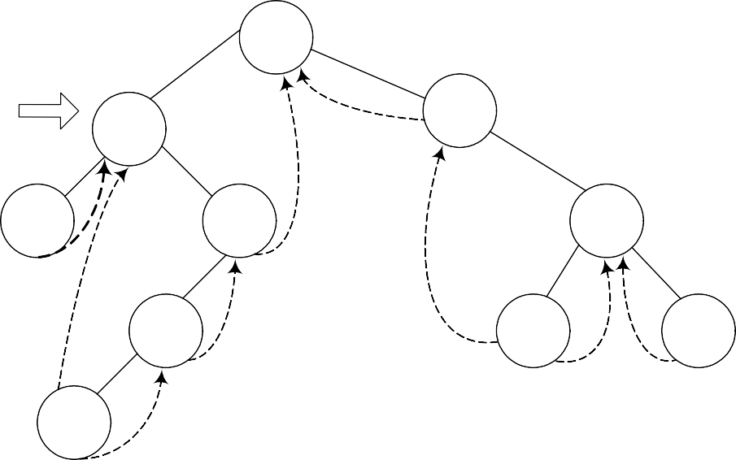
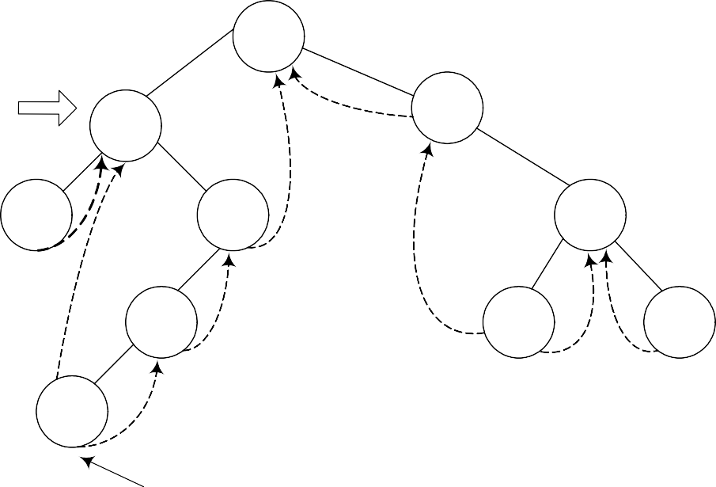
CS301 – Data Structures
Lecture No. 27
Inorder successor of 4.
14
4
15
3
9
18
7
16
20
5
Fig 27.11
We are at node 4 and want to find its inorder successor. If you remember the delete operation discussed in the previous lecture, where we searched for the inorder successor and found it to be the left-most node in the right subtree of the node.
Inorder successor of 4.
14
4
15
3
9
18
7
16
20
5
Fig 27.12
Left most node in right subtree of 4
In this figure, the right subtree of 4 is starting from node 9 and ending at node 5. Node 5 is the left most node of it and this is also the inorder successor of node 4. We cannot go to node 5 directly from node 4, we go to node 9 first then node 7 and finally to node 5.

Slide 23
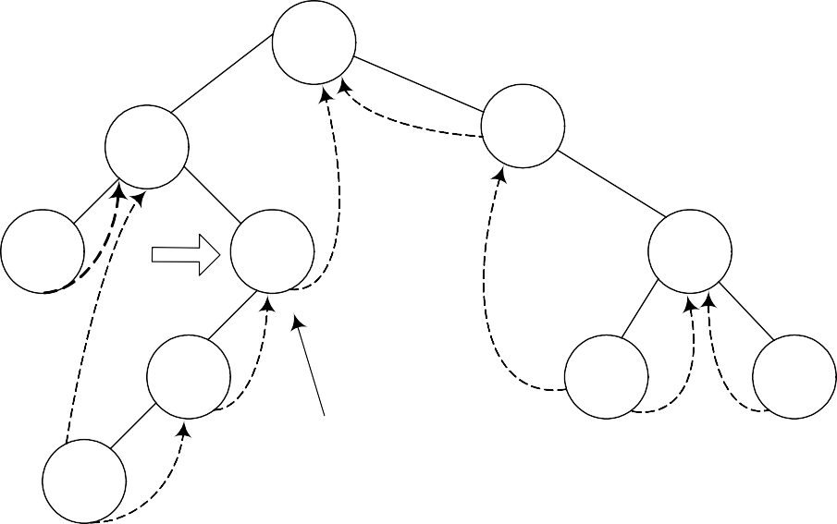
CS301 – Data Structures
Lecture No. 27
Inorder successor of 9.
14
4
15
3
9
18
7
16
20
Follow right thread to 14.
5
Fig 27.13
We move from node 9 to node 5 following the normal tree link and not thread. As long as the normal left tree link is there of a node, we have set the LTH flag to child. When we reach at node 5, the left link is a thread and it is indicated with a flag. See the while loop given in the above routine again:
while(p->LTH == child) p = p->L;
return p;

Slide 24
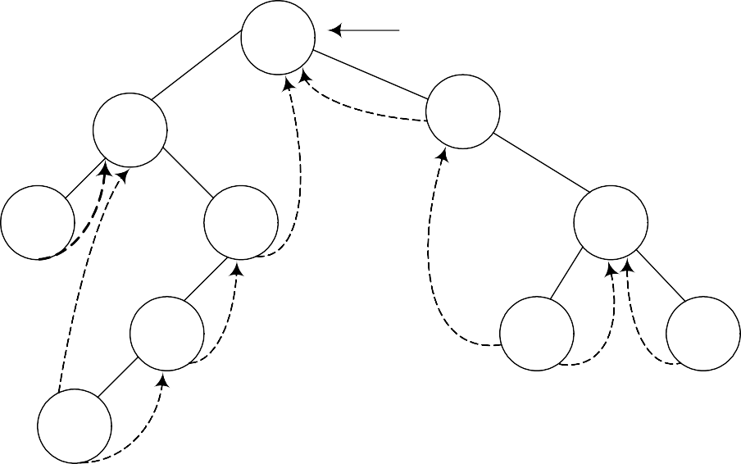
CS301 – Data Structures
Lecture No. 27
Inorder Traversal
Now by using this routine, we try to make our inorder traversal procedure that is non- recursive and totally stack free.
If we can get things started correctly, we can simply call nextInorder repeatedly (in a simple loop) and move rapidly around the tree inorder printing node labels (say) - without a stack.
14
P
4
15
3
9
18
7
16
20
5
Fig 27.14
The pointer p is pointing to the root node of the tree. If we start traversing from this node and pass this root node pointer to our routine nexInorder above, it will create a problem.
We see the routine again to see the problem area clearly: TreeNode* nextInorder(TreeNode* p)
{
if(p->RTH == thread)
return(p->R);
else {
p = p->R;
while(p->LTH == child) p = p->L;
return p;
}
}
In the first part, it is checking for the RTH flag to be set to thread, which is not the case for the root node. The control will be passed to the else part of the routine. In else part, in the very first step, we are moving towards right of root that is to node 15.

Slide 25
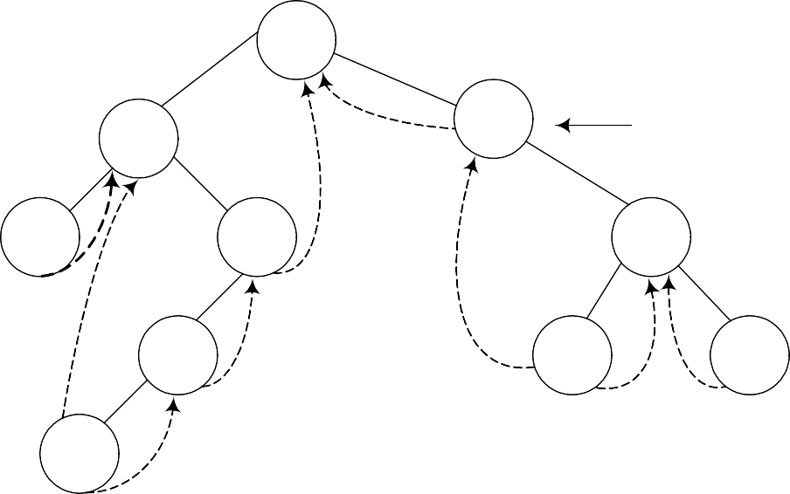
CS301 – Data Structures
Lecture No. 27
14
4
15
P ?
3
9
18
7
16
20
5
Fig 27.15
If we call nextInorder with the root of the binary tree, we're going to have some difficulty. The code won't work at all the way we want.
Note that in this tree inorder traversal, the first number we should print is 3 but now we have reached to node 15 and we don’t know how can we reach node 3. This has created a problem. In the lecture, we will make a small change in this routine to cater to this situation i.e. when a root node pointer is passed to it as a parameter. After that change the routine will work properly in case of root node also and it will be non- recursive, stack free routine to traverse the tree.

Slide 26
CS301 – Data Structures
Lecture No. 28
Data Structures Lecture No. 28
Reading Material
Data Structures and Algorithm Analysis in C++
Chapter. 6
6.3.1
Summary
•
•
Inorder traversal in threaded trees Complete Binary Tree
Inorder traversal in threaded trees
Discussion on the inroder traversal of the threaded binary tree will continue in this lecture. We have introduced the threads in the tree and have written the nextInorder routine. It is sure that the provision of the root can help this routine perform the inorder routine properly. It will go to the left most node before following the threads to find the inorder successors. The code of the routine is given below:
/* The inorder routine for threaded binary tree */
TreeNode* nextInorder(TreeNode* p){
if(p->RTH == thread) return(p->R); else {
p = p->R;
while(p->LTH == child) p = p->L;
return p;
}
}
When we apply this routine on the sample tree, it does not work properly because the pointer that points to the node goes in the wrong direction. How can we fix this problem? Let’s review the threaded binary tree again:

Slide 27
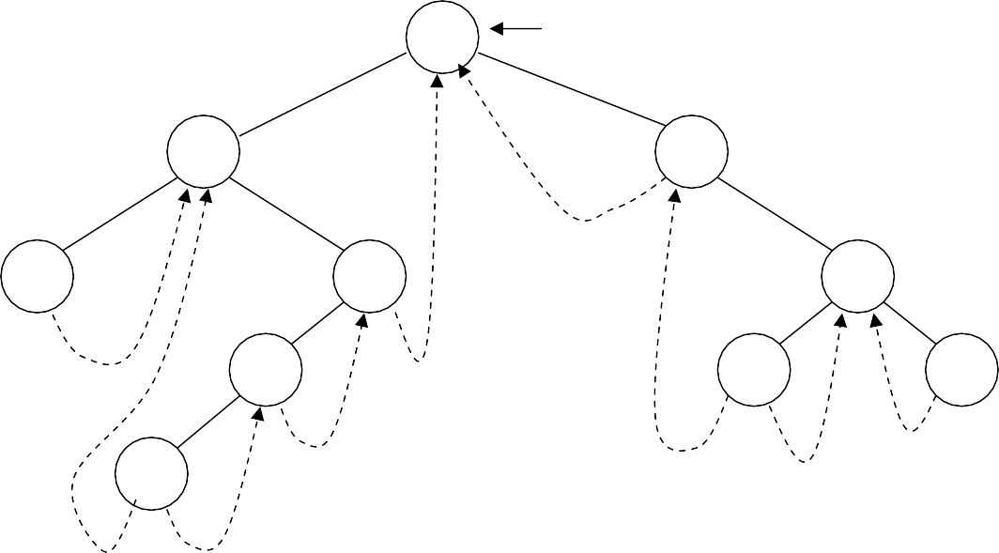
CS301 – Data Structures
Lecture No. 28
14
p
4
15
3
9
18
7
16
20
5
In the above figure, we have a binary search tree. Threads are also seen in it. These threads points to the successor and predecessor.
Our nextInoder routine, first of all checks that the right pointer of the node is thread. It means that it does not point to any tree node. In this case, we will return the right pointer of the node as it is pointing to the inorder successor of that node. Otherwise, we will go to some other part. Here we will change the value of pointer p to its right before running a while loops as long as the left pointer is the node. That means the left child is not a thread. We move to the left of the pointer p and keep on doing so till the time the left pointer becomes a thread.
We will pass the root of the tree to the nextInorder routine. The pointer p is pointing to the node 14 i.e. the root node. As the right pointer of the node 14 is not a thread, so the pointer p will move to the node 15 as shown below:

Slide 28
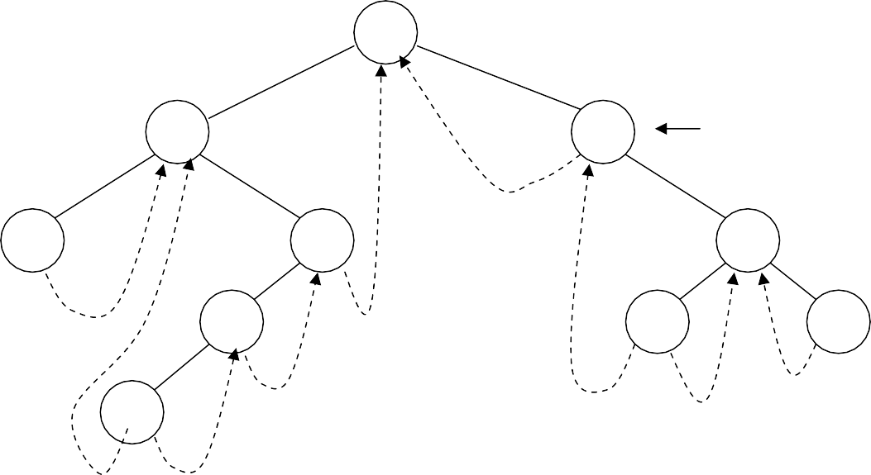
CS301 – Data Structures
Lecture No. 28
14
4
15
p?
3
9
18
7
16
20
5
Here we want the inorder traversal. It is obvious from the above figure that 15 is not the first value. The first value should be 3. This means that we have moved in the
wrong direction. How this problem can be overcome? We may want to implement some logic that in case of the root node, it is better not to go towards the right side. Rather, the left side movement will be appropriate. If this is not the root node, do as
usual. It may lend complexities to our code. Is there any other way to fix it? Here we will use a programming trick to fix it.
We will make this routine as a private member function of the class so other classes do not have access to it. Now what is the trick? We will insert a new node in the tree. With the help of this node, it will be easy to find out whether we are on the root node or not. This way, the pointer p will move in the correct direction.
Let’s see this trick. We will insert an extra node in the binary tree and call it as a dummy node. This is well reflected in the diagram of the tree with the dummy node. We will see where that dummy node has been inserted.

Slide 29
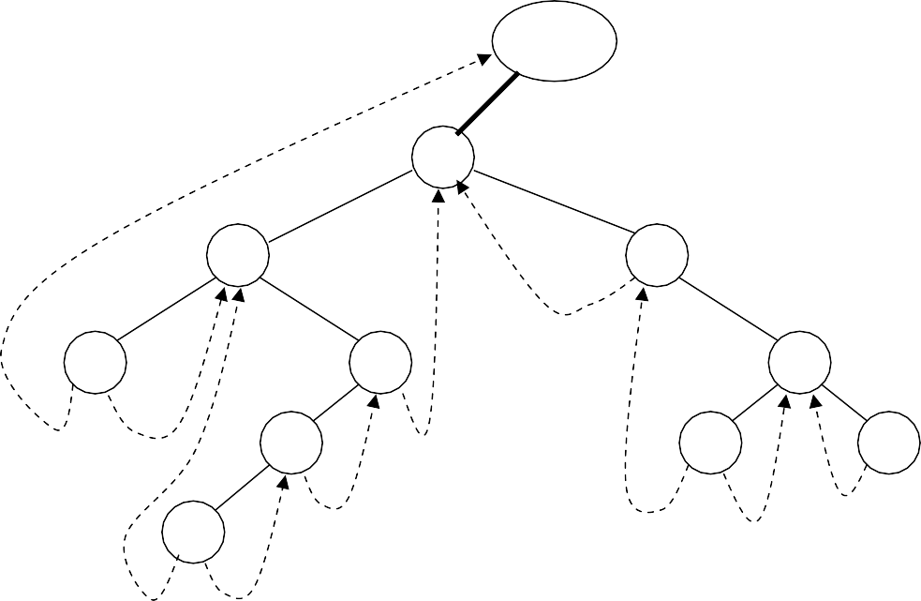
CS301 – Data Structures
Lecture No. 28
dummy
14
4
15
3
9
18
7
16
20
5
This dummy node has either no value or some dummy value. The left pointer of this
node is pointing to the root node of the tree while the right pointer is seen pointing itself i.e. to dummy node. There is no problem in doing all these things. We have put the address of dummy node in its right pointer and pointed the left thread of the left most node towards the dummy node. Similarly the right thread of the right-most node is pointing to the dummy node. Now we have some extra pointers whose help will make the nextInorder routine function properly.
Following is a routine fastInorder that can be in the public interface of the class.
/* This routine will traverse the binary search tree */
void fastInorder(TreeNode* p)
{
while((p=nexInorder(p)) != dummy) cout << p->getInfo();
}
This routine takes a TreeNode as an argument that make it pass through the root of the tree. In the while loop, we are calling the nextInorder routine and pass it p. The pointer returned from this routine is then assigned to p. This is a programming style of
C. We are performing two tasks in a single statement i.e. we call the nextInorder by passing it p and the value returned by this routine is saved in p. Then we check that
the value returned by the nextInorder routine that is now actually saved in p, is not a
dummy node. Then we print the info of the node. This function is called as:
fastInorder(dummy);
We are not passing it the root of the tree but the dummy node. Now we will get the correct values and see in the diagrams below that p is now moving in the right direction. Let’s try to understand this with the help of diagrams.

Slide 30
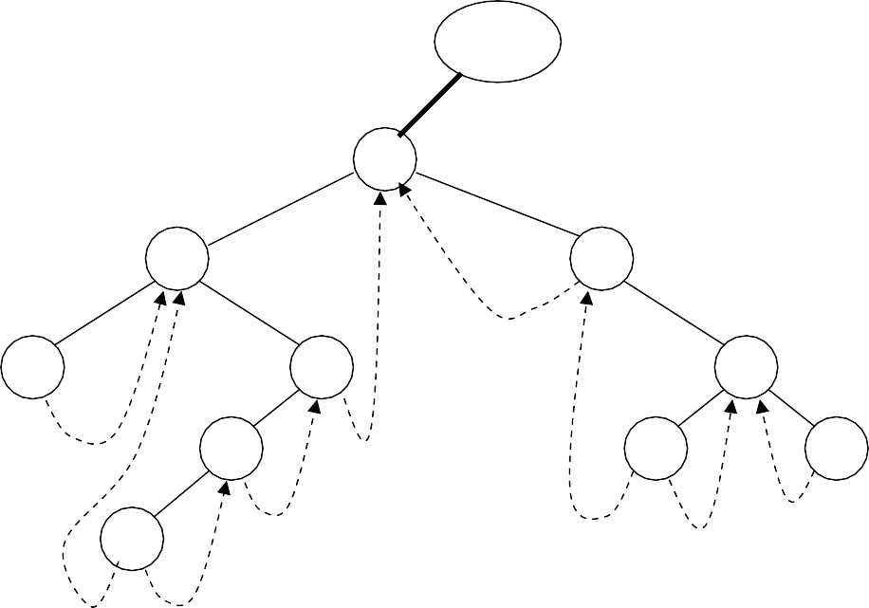
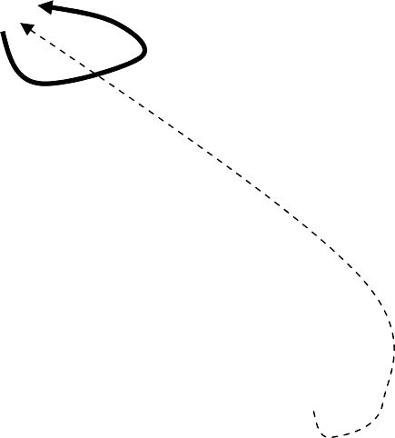
CS301 – Data Structures
Lecture No. 28
First of all we call the nextInorder routine passing it the dummy node.
p
dummy
14
4
15
3
9
18
7
16
20
5
The pointer p is pointing to the dummy node. Now we will check whether the right pointer of this node is not thread. If so, then it is advisable to move the pointer
towards the right pointer of the node. Now we will go to the while loop and start moving on the left of the node till the time we get a node with the left pointer as
thread. The pointer p will move from dummy to node 14. As the left pointer of node 14 is not thread so p will move to node 4. Again the p will move to node 3. As the left pointer of p is thread, the while loop will finish here. This value will be returned that is pointing to node 3. The node 3 should be printed first of all regarding the inorder traversal. So with the help of our trick, we get the right information.
Now the while loop in the fastInorder will again call the nextInorder routine. We have updated the value of p in the fastInorder that is now pointing to the node 3. This is shown in the figure below:

Slide 31


CS301 – Data Structures
Lecture No. 28
dummy
14
4
15
p
3
9
18
7
16
20
5
According to the code, we have to follow the right thread of the node 3 that is pointing to the node 4. Therefore p is now pointing to the node 4. Here 4 is inorder successor of 3. So the pointer p has moved to the correct node for inorder traversal.
As the right pointer of the node 4 is a link, p will move to node 9. Later, we will go on the left of nodes and reach at the node 5. Looking at the tree, we know that the inorder successor of the node 4 is node 5. In the next step, we will get the node 7 and so on. With the help of threads and links, we are successful in getting the correct inorder traversal. No recursive call has been made so far. Therefore stack is not used. This inorder traversal will be faster than the recursive inorder traversal. When other classes use this routine, it will be faster. We have not used any additional memory for this routine. We are using the null links and putting the values of thread in it. This routine is very simple to understand. In the recursive routines, we have to stop the recursion at some condition. Otherwise, it will keep on executing and lead to the aborting of our program.
Complete Binary Tree
We have earlier discussed the properties of the binary trees besides talking about the internal and external nodes’ theorem. Now we will discuss another property of binary trees that is related to its storage before dilating upon the complete binary tree and the heap abstract data type.
Here is the definition of a complete binary tree:
A complete binary tree is a tree that is completely filled, with the possible exception of the bottom level.
The bottom level is filled from left to right.
You may find the definition of complete binary tree in the books little bit different from this. A perfectly complete binary tree has all the leaf nodes. In the complete binary tree, all the nodes have left and right child nodes except the bottom level. At the bottom level, you will find the nodes from left to right. The bottom level may not

Slide 32
CS301 – Data Structures Lecture No. 28
be completely filled, depicting that the tree is not a perfectly complete one. Let’s see a complete binary tree in the figure below:
A
B
C
D
E
F
G
H I J
In the above tree, we have nodes as A, B, C, D, E, F, G, H, I, J. The node D has two children at the lowest level whereas node E has only left child at the lowest level that is J. The right child of the node E is missing. Similarly node F and G also lack child nodes. This is a complete binary tree according to the definition given above. At the lowest level, leaf nodes are present from left to right but all the inner nodes have both children. Let’s recap some of the properties of complete binary tree.
A complete binary tree of height h has between 2^{h} to 2^{h+1} –1 nodes.
The height of such a tree is log₂N where N is the number of nodes in the tree.
Because the tree is so regular, it can be stored in an array. No pointers are necessary.
We have taken the floor of the log₂ N. If the answer is not an integer, we will take the next smaller integer. So far, we have been using the pointers for the implementation of trees. The treeNode class has left and right pointers. We have pointers in the balance tree also. In the threaded trees, these pointers were used in a different way. But now we can say that an array can be stored in a complete binary tree without needing the help of any pointer.
Now we will try to remember the characteristics of the tree. 1) The data element can be numbers, strings, name or some other data type. The information is stored in the node. We may retrieve, change or delete it. 2) We link these nodes in a special way
i.e. a node can have left or right subtree or both. Now we will see why the pointers are
being used. We just started using these. If we have some other structure in which trees can be stored and information may be searched, then these may be used. There should be reason for choosing that structure or pointer for the manipulation of the trees. If we have a complete binary tree, it can be stored in an array easily.

Slide 33
CS301 – Data Structures Lecture No. 28
The following example can help understand this process. Consider the above tree again.
A
B
C
D
E
F
G
H
I
J
 | A | B | C | D | E | F | G | H | I | J
1 2 3 4 5 6 7 8 9 10 11 12 13 14
We have seen an array of size 15 in which the data elements A, B, C, D, E, F, G, H, I, J have been stored, starting from position 1. The question arises why we have stored the data element this way and what is justification of storing the element at the 1st position of the array instead of 0th position? You will get the answers of these very shortly.
The root node of this tree is A and the left and right children of A are B and C. Now look at the array. While storing elements in the array, we follow a rule given below:
For any array element at position i, the left child is at 2i, the right child is at (2i
+1) and the parent is at floor(i/2).
In the tree, we have links between the parent node and the children nodes. In case of having a node with left and right children, stored at position i in the array, the left child will be at position 2i and the right child will be at 2i+1 position. If the value of i is 2, the parent will be at position 2 and the left child will be at position 2i i.e. 4 .The right child will be at position 2i+1 i.e. 5. You must be aware that we have not started from the 0th position. It is simply due to the fact if the position is 0, 2i will also become 0. So we will start from the 1st position, ignoring the 0th.
Lets see this formula on the above array. We have A at the first position and it has two children B and C. According to the formula the B will be at the 2i i.e. 2nd position and C will be at 2i+1 i.e. 3rd position. Take the 2nd element i.e. B, it has two children D and E. The position of B is 2 i.e. the value of i is 2. Its left child D will be at positon 2i
i.e. 4th position and its right child E will be at position 2i+1 i.e. 5. This is shown in the

Slide 34
CS301 – Data Structures
Lecture No. 28
figure below:
 | A | B | C | D | E | F | G | H | I | J
0 1 2 3 4 5 6 7 8 9 10 11 12 13 14
If we want to keep the tree’s data in the array, the children of B should be at the position 4 and 5. This is true. We can apply this formula on the remaining nodes also. Now you have understood how to store tree’s data in an array. In one respect, we are using pointers here. These are not C++ pointers. In other words, we have implicit pointers in the array. These pointers are hidden. With the help of the formula, we can obtain the left and right children of the nodes i.e. if the node is at the ith position, its children will be at 2i and 2i+1 position. Let’s see the position of other nodes in the array.
As the node C is at position 3, its children should be at 2*3 i.e. 6th position and 2*3+1
i.e. 7th position. The children of C are F and G which should be at 6th and 7th position. Look at the node D. It is at position 4. Its children should be at position 8 and 9. E is at position 5 so its children should be at 10 and 11 positions. All the nodes have been stored in the array. As the node E does not have a right child, the position 11 is empty in the array.
 | A | B | C | D | E | F | G | H | I | J
0 1
2
3
4 5 6 7 8 9 10 11 12 13 14
You can see that there is only one array going out of E. There is a link between the parent node and the child node. In this array, we can find the children of a node with
the help of the formula i.e. if the parent node is at ith position, its children will be at 2i
and 2i+1 position. Similarly there is a link between the child and the parent. A child can get its parent with the help of formula i.e. if a node is at ith position, its parent will be at floor(i/2) position. Let’s check this fact in our sample tree. See the diagram below:

Slide 35
CS301 – Data Structures
Lecture No. 28
1
A
2
3
B
C
4
5
6
7
G
D
E
F
8
9
10
H
I
J
 | A | B | C | D | E | F | G | H | I | J
0 1 2 3 4 5 6 7 8 9 10 11
Level Order Numbers & Array index
12 13 14
Consider the node J at position is 10. According to the formula, its parent should be at floor(10/2) i.e. 5 which is true. As the node I is at position 9, its parent should be at floor(9/2) i.e. 4. The result of 9/2 is 4.5. But due to the floor, we will round it down and the result will be 4. We can see that the parent of I is D which is at position 4. Similarly the parent of H will be at floor(8/2). It means that it will be at 4. Thus we see that D is its parent. The links shown in the figure depict that D has two children H and I. We can easily prove this formula for the other nodes.
From the above discussion we note three things. 1) We have a complete binary tree, which stores some information. It may or may not be a binary search tree. This tree can be stored in an array. We use 2i and 2i+1 indexing scheme to put the nodes in the array. Now we can apply the algorithms of tree structure on this array structure, if needed.
Now let’s talk about the usage of pointers and array. We have read that while implementing data structures, the use of array makes it easy and fast to add and remove data from arrays. In an array, we can directly locate a required position with the help of a single index, where we want to add or remove data. Array is so important that it is a part of the language. Whereas the data structures like tree, stack and queue are not the part of C or C++ language as a language construct. However we can write our classes for these data structures. As these data structures are not a part of the language, a programmer can not declare them directly. We can not declare a tree or a stack in a program. Whereas we can declare an array directly as int x []; The array data type is so efficient and is of so common use that most of the languages support it. The compiler of a language handles the array and the programmer has to do nothing for declaring and using an array.

Slide 36
CS301 – Data Structures Lecture No. 28
We have built the binary trees with pointers. The use of pointers in the memory requires some time. In compilers or operating system course, we will read that when a program is stored in the memory and becomes a process, the executable code does not come in the memory. There is a term paging or virtual memory. When a program executes, some part of it comes in the memory. If we are using pointers to go to different parts of the program, some part of the code of program will be coming (loading) to memory while some other may be removed (unloading) from the memory. This loading and unloading of program code is executed by a mechanism, called paging. In Windows operating system, for this virtual memory (paging mechanism), a file is used, called page file. With the use of pointers, this process of paging may increase. Due to this, the program may execute slowly. In the course of Operating System and Compilers, you will read in detail that the usage of pointers can cause many problems.
So we should use arrays where ever it can fulfill our requirements. The array is a very fast and efficient data structure and is supported by the compiler. There are some situations where the use of pointers is beneficial. The balancing of AVL tree is an example in this regard. Here pointers are more efficient. If we are using array, there will be need of moving a large data here and there to balance the tree.
From the discussion on use of pointers and array, we conclude that the use of array should be made whenever it is required. Now it is clear that binary tree is an important data structure. Now we see that whether we can store it in an array or not. We can surely use the array. The functions of tree are possible with help of array. Now consider the previous example of binary tree. In this tree, the order of the nodes that we maintained was for the indexing purpose of the array. Moreover we know the level-order traversal of the tree. We used queue for the level-order of a tree. If we do level-order traversal of the tree, the order of nodes visited is shown with numbers in the following figure.
1
A
2
3
B
C
4
5
6
7
G
D
E
F
8
9
10
H
I
J
 | A | B | C | D | E | F | G | H | I | J
0 1 2 3 4 5 6 7 8 9 10 11 12 13 14

Slide 37
CS301 – Data Structures Lecture No. 28
In the above figure, we see that the number of node A is 1. The node B is on number 2 and C is on number 3. At the next level, the number of nodes D, E, F and G are 4, 5, 6 and 7 respectively. At the lowest level, the numbers 8, 9 and 10 are written with nodes H, I and J respectively. This is the level-order traversal. You must remember that in the example where we did the preorder, inorder and post order traversal with recursion by using stack. We can do the level-order traversal by using a queue. Now after the level-order traversal, let’s look at the array shown in the lower portion of the above figure. In this array, we see that the numbers of A, B, C and other nodes are the same as in the level-order traversal. Thus, if we use the numbers of level-order traversal as index, the values are precisely stored at that numbers in the array. It is easy for us to store a given tree in an array. We simply traverse the tree by level-order and use the order number of nodes as index to store the values of nodes in the array. A programmer can do the level-order traversal with queue as we had carried out in an example before. We preserve the number of nodes in the queue before traversing the queue for nodes and putting the nodes in the array. We do not carry out this process, as it is unnecessarily long and very time consuming. However, we see that the level- order traversal directly gives us the index of the array depending upon which data can be stored.

Slide 38
CS301 – Data Structures
Lecture No. 29
Data Structures Lecture No. 29
Reading Material
Data Structures and Algorithm Analysis in C++
Chapter. 6
6.3
Summary
•
•
•
•
Complete Binary Tree Heap
Max Heap Insertion in a Heap
Complete Binary Tree
In the previous lecture, we talked about the ways to store a complete binary tree in an array. The 2i and 2i+1 scheme were employed to store the link of the parent to children and link of children to parent. Through this link, a programmer can go to the children of a node. We know that array is a very efficient data structure. In a number of languages, it is found as a built-in data type. Now the question arises if we can store the binary tree in an array, why there should be the use of pointers? It is very simple that an array is used when the tree is a complete binary tree. Array can also be used for the trees that are not complete binary trees. But there will be a problem in this case. The size of the array will be with respect to the deepest level of the tree according to the traversal order. Due to incomplete binary tree, there will be holes in the array that means that there will be some positions in the array with no value of data. We can understand it with a simple example. Look at the following figure where we store a complete binary tree in an array by using 2i and 2i+1 scheme. Here we stored the nodes from A to J in the array at index 1 to 10 respectively.

Slide 39
CS301 – Data Structures
Lecture No. 29
1
A
2
3
B
C
4
5
6
7
G
D
E
F
8
9
10
H
I
J
 | A | B | C | D | E | F | G | H | I | J
0 1 2 3 4 5 6 7 8 9 10 11 12 13 14
Figure 29.1: Complete Binary Tree
Suppose that this tree is not complete. In other words, B has no right subtree that means E and J are not there. Similarly we suppose that there is no right subtree of A. Now the tree will be in the form as shown in the following figure (29.2).
1
A
2
B
4
D
8
H
9
I
 | A | B |  | D |  |  |  | H | I
0 1 2 3 4 5 6 7 8 9 10 11 12
Figure 29.2: Not a complete binary tree
13 14

Slide 40
CS301 – Data Structures Lecture No. 29
In this case, the effort to store this tree in the array will be of no use as the 2i and 2i+1 scheme cannot be applied to it. To store this tree, it may be supposed that there are nodes at the positions of C, F, G, E and J (that were there in previous figure). Thus we transform it into a complete binary tree. Now we store the tree in the array by using 2i and 2i +1 scheme. Afterwards, the data is removed from the array at the positions of the imaginary nodes (in this example, the nodes are C, F, G, E and J). Thus we notice that the nodes A, B and H etc are at the positions, depicting the presence of a complete binary tree. The locations of C, f, G, E and J in the array are empty as shown in the following figure.
 | A | B |  | D |  |  |  | H | I
0 1 2 3 4 5 6 7 8 9 10 11 12 13 14
Now imagine that an incomplete binary tree is very deep. We can store this tree in the array that needs to be of large size. There will be holes in the array. This is the wastage of memory. Due to this reason, it is thought that if a tree is not completely binary, it is not good to store it into an array. Rather, a programmer will prefer to use pointers for the storage.
Remember that two things are kept into view while constructing a data structure that is memory and time. There should such a data structure that could ensure the running of the programs in a fast manner. Secondly, a data structure should not use a lot of memory so that a large part of memory occupied by it does not go waste. To manage
the memory in an efficient way, we use dynamic memory with the help of pointers. With the use of pointers only the required amount of memory is occupied.
We also use pointers for complex operations with data structure as witnessed in the
deletion operation in AVL tree. One of the problems with arrays is that the memory becomes useless in case of too many empty positions in the array. We cannot free it and use in other programs as the memory of an array is contiguous. It is difficult to free the memory of locations from 50 to 100 in an array of 200 locations. To manage the memory in a better way, we have to use pointers.
Now we come to a new data structure, called ‘heap’.
Heap
Heap is a data structure of big use and benefit. It is used in priority queue. Recall the example of bank simulation. In that case, we used event-based queues. We put the events that were going to happen in a special queue i.e. priority queue. This priority queue does not follow the FIFO rule. We put the elements in the queue at the end but later got the element with respect to its priority. We get the element that is going to occur first in the future. In that example, we implemented the priority queue with arrays. It was seen that when we insert an element in the queue, the internally used data was sorted in the array. Thus the event with minimum time of occurrence becomes at first position in the sorted array. We get the event with minimum time first. After the removal of the element, a programmer shifts the array elements to left. When we insert a new element, the array is sorted again. As there, in the bank example, were five or six events, the use of array fulfilled our requirement. We need not to have other data type that makes the queue efficient. The array is efficient but sorting is an expensive procedure. It may be complex and time-consuming. Secondly, we have to shift elements while adding or removing them from the array. Thus the

Slide 41
CS301 – Data Structures Lecture No. 29
implementation of priority queue with an array is not efficient in terms of time. There is an alternate that is called heap. The use of priority queue with the help of heap is a major application. The priority queue is itself a major data structure, much-used in operating systems. Similarly priority queue data structure is used in network devices especially in routers. Heap data structure is also employed in sorting algorithms. There are also other uses of heap.
Let’s discuss the heap data structure with special reference to its definition,
“The definition of heap is that it is a complete binary tree that conforms to the heap order”.
In this definition there is a term ‘heap order’. The heap order is a property that states that in a (min) heap for every node X, the key in the parent is smaller than (or equal to) the key in X. In other words, the parent node has key smaller than or equal to both of its children nodes. This means that the value in the parent node is less than the value on its children nodes. It is evident from the definition that we implement the heap by complete binary tree. It can also be implemented by some other method. But normally, we implement heap with complete binary tree. We know that in a binary search tree, the value of a node is greater than the values in its left subtree and less than the values in its right subtree. The heap has a variation to it. In heap, the value of a node is less than the values of its left and right children. The values in left and right children may be more or less with each other but these will be greater than the value in their parent node.
Consider the tree shown in the following figure.
13
21
16
24
31
19
68
65
26
32
Figure 29.3: A min heap
This is a complete binary tree. Now consider the values (numbers) in the nodes. This is not a binary search tree. If we carry out the inorder traversal, the result will be
65, 24, 26, 21, 32, 31, 13, 19, 16, 68.
We can see that it is not in a sorted order as got while traversing a binary search tree. So it is not a binary search tree. It’s simply a complete binary tree.
Now we see the heap order in this tree. We start from node having value 13. Its left

Slide 42
CS301 – Data Structures Lecture No. 29
child has value 21 while the value possessed by the right child is 16. So this is in line with the heap order property. Now we come to node 21. The values in its left and right child are 24 and 31 respectively. These values are greater than 21. Thus, it also fulfills the heap order property. Now we consider the node having value 16. The value in left child node of it is 19 and value in right child node is 68. So the value of parent node (i.e. 16) is less than the values of its children nodes. Similarly we can see other nodes. The node 24 is less than its children that are 65 and 26 respectively. And the node 31 is less than its child i.e. 32. Now for this tree, three things have been proved. First, this is a binary tree. Secondly it is a complete binary tree. Thirdly it fulfills the heap order property i.e. the value of the parent node is less than that of its left and right child nodes. This property is valid for every node of the tree. The leaf nodes have no child so there is no question of heap property. The heap shown in the figure above is a min heap. In the min heap, the value of parent node is less than the values in its child nodes. Thus in a min heap, the value of the root node is the smallest value in the tree.
Now consider the tree in the following figure. This is a complete binary tree. This is neither a search tree, nor a heap.
13
©
21
19
©
6
31
16
68
65
26
32
Figure 29.4: Not a heap
Look at the node having value 19. The values in its left and right child nodes are 16 and 68 respectively. Thus the value of left child (i.e. 16) is less than that of the parent. So it is not a heap. If it were a heap or min heap, the value 16 should have been parent and the value 19 should have its child. Due to this violation, (the value of child is less than that of the parent) it is not a heap (min heap).
Max Heap
We can also make a max heap. In max heap, each node has a value greater than the value of its left and right child nodes. Moreover, in this case, the value of the root node will be largest and will become lesser at downward levels. The following figure shows a max heap.

Slide 43
CS301 – Data Structures
Lecture No. 29
73
52
63
40
31
27
57
25
26
13
Figure 29.5: A max heap
Consider the min heap again. By removing the root from the min heap, we get the smallest value. Now if the remaining values adjust themselves to again form a heap, the minimum value among these remaining values will get on the top. And if we remove this value, there will be the second minimum value of the heap. The remaining values again form a heap and there will be the smallest number among these on the top. Thus we will get the third minimum number. If we continue this process of getting the root node and forming a heap of remaining values, the numbers will get in ascending order. Thus we get the sorted data. By putting data in heap and getting it in a particular way, we achieve a sorting procedure. This way, a programmer gets sorted data.
Now suppose that the numbers in heap are priorities or events. If we build the max
heap, the number with greater priority will get on the top. Now if we get data from the heap, the data on top will be gotten first. As it is max heap, the data on top will be the largest value.
Insertion in a Heap
Now let’s discuss the insertion of a value in a min or max heap. We insert a value in a min heap and rearrange it in such a way that the smallest value gets on the top. Similarly, if we are inserting a value in a max heap, the largest value goes on the top. To discuss insertion in min heap, consider the following existing heap. This is the same heap discussed earlier. As it is a complete binary tree, we keep it in an array. In the figure, the level order of numbers of the nodes is also seen that describes the position of nodes (index number) in the array.

Slide 44
CS301 – Data Structures
Lecture No. 29
1
13
2
21
3
16
4
24
5
31
19
6
7 68
8
65
9
26
10
32
 | 13 | 21 | 16 | 24 | 31 | 19 | 68 | 65 | 26 | 32
0 1
2
3
4 5 6 7 8 9
Figure 29.6: An existing heap
10 11 12 13 14
Now we add a new node to this existing heap. Suppose the node that we want to add has a value 14. We will add this node at a position in such a way that the tree should remain complete binary one. Following this guideline, this node will be added on right side of node 31. In the array, the node 31 is presently at position 5. Now according to the formula of 2i and 2i+1, the left child of 31 will be at positions 10 that
already exists. The right child of 31 (that is 14 now) will be at position 11 in the array. This addition of node in the tree and value in the array is shown in the following figure. We have shown the node link and position in the array with dotted lines. By this, it is shown that the node of value 14 may become here. We did not actually put it there. We have to put it at such position so that the heap should remain intact.

Slide 45
CS301 – Data Structures
Lecture No. 29
1
13
2
21
3
16
4
24
5
31
19
6
7 68
8
65
9
26
10
32
11
14
 | 13 | 21 | 16 | 24 | 31 | 19 | 68 | 65 | 26 | 32 | 14
0 1
2
3
4 5 6 7 8 9 10 11 12 13 14
Figure 29.7: inserting new value in a heap
With the addition of new node, we see that this is still a complete binary tree and can be stored in an array. There are no holes in the array, leading to no wastage of the positions.
Now preservation of the heap order is needed. We are discussing the min heap in this
example. In the min heap, the smallest element is at the top (root). And at each level, every node has a smaller value than that of its children nodes. Now we have to put the node 14 at its proper position with respect to heap order. Thus heap is being implemented with complete binary tree with the help of an array. We have to find the final; position of node 14 in the tree and array preserving the heap order. A look on the tree in the previous figure shows that if we put node 14 (shown with dotted line) at that position, the heap order will not be preserved. By considering the node 31, we see that the value of its right child (i.e. 14) is less than it. Thus heap property is violated. To preserve heap property, the node 14 should be up and node 31 should be down. If node 14 is at position of 31 and it is compared with its parent that is 21, we come to know that node 21 should also be at down position. How do we take node 14 to its proper position? To achieve this objective, we have to take node 21 and 31 down and move the node 14 up. Now let’s see how we can do this. In the following figure, the position is seen where a new node can be added with an empty circle (hole). The value of this node is not shown. However, the new inserted value may go to that position. Similarly in the array we show that there will be some value at position 11.

Slide 46
CS301 – Data Structures
Lecture No. 29
1
13
2
21
3
16
4
24
5
31
19
6
7 68
8
65
9
26
10
32
11
 | 13 | 21 | 16 | 24 | 31 | 19 | 68 | 65 | 26 | 32
0 1
2
3
4 5 6 7 8 9 10 11 12 13 14
Figure 29.8: inserting new value in a heap
Now we compare the new value to be inserted (that is 14) at position 11 with its parent node. The parent node of newly inserted node is 31 that is greater than the new value. This is against the (min) heap property. According to the heap property, the node 14 may be the parent of 31 but not its child. So we move the node 31 to the position 11 and the new node to the position 5 that was earlier the position of 31. This
technique is also employed in the array. Thus we get the array and tree in the form as shown in the following figure.
1
13
2
21
3
16
4
24
5
19 6
7 68
8
65
9
26
10
32
11
31

Slide 47
CS301 – Data Structures
Lecture No. 29
 | 13 | 21 | 16 | 24 |  | 19 | 68 | 65 | 26 | 32 | 31
0 1
2
3
4 5 6 7 8 9 10 11 12 13 14
Figure 29.9: inserting new value in a heap
Now if the new node comes at the position 5, its parent (that is node 21 at position 2) is again greater than it. This again violates the heap property because the parent (i.e.
21) is greater than the child whose value is 14. So we bring the node 21 down and take the new node up. Thus the node 21 goes to the position 5 and the new node
attains the position 2 in the tree and array as shown in the following figure.
1
13
2
3
16
4
24
5
21
19 6
7 68
8
65
9
26
10
32
11
31
 | 13 |  | 16 | 24 | 21 | 19 | 68 | 65 | 26 | 32 | 31
0 1
2
3
4 5 6 7 8 9 10 11 12 13 14
Figure 29.10: inserting new value in a heap
To interchange the positions of values in the array, only these values are swapped which is very easy process. We can do this easily in arrays. Now if the new value 14 comes at the position 2, the heap property will be preserved due to the fact that the

Slide 48
CS301 – Data Structures Lecture No. 29
parent of this node i.e. the node of value 13 is less than its child (the new node that is 14). Thus the final position of new node 14 is determined and we put it here i.e. at position 2. This is shown in the following figure.
1
13
2
14
3
16
4
24
5
21
19
6
7 68
8
65
9
26
10
32
11
31
 | 13 | 14 | 16 | 24 | 21 | 19 | 68 | 65 | 26 | 32 | 31
0 1
2
3
4 5 6 7 8 9 10 11 12 13 14
Figure 29.11: inserting new value in a heap
It is clear by now that the tree after insertion of a new value follows the heap property.
We see that there is an algorithm for inserting a new value in the heap. If we have a heap stored in an array as a complete binary tree, a new value is put in the array at a position so that it can hold preserving the property of complete binary tree. In our example, it is the position 11 where new value may be put. We know that the parent of a node is at position floor (i / 2). Thus we find the position of parent node of the new node and compare this new value with that. If the parent node has a value greater than this new value (i.e. its child), the heap property is violated. To maintain this property, we exchange these values. Now at the new position we find the parent of that position and compare the value with the value at that position. Thus the array is traversed by level-order. After a comparison, we go one level up in the tree. And we go to upward by looking at the parent node of the newly inserted node level by level. We stop at the position where the value of the parent node is less than the value of its child i.e. the node to be inserted. To insert a node, it is necessary to find the position of the node before putting the value there. This is efficient and fast way as actual values are not exchange in this case. We simply move the data. Under the second method, it can also be done with exchanges. Let’s do this for our previous heap. Look at the following figure. Here we put the new node 14 at its position. It is the right child of node 31. We have already seen that this is the position where a new node can

Slide 49
CS301 – Data Structures Lecture No. 29
be added so that the tree remains complete binary tree. In the array, it is at position 11.
1
13
2
21
3
16
4
24
5
31
19
6
7
68
8
65
9
26
10
32
11
14
 | 13 | 14 | 16 | 24 | 21 | 19 | 68 | 65 | 26 | 32 | 31
0 1
2
3
4 5 6 7 8 9 10 11 12 13 14
Figure 29.12: inserting new value in a heap
Now we check the heap order and compare node 14 with its parent that is node 31. It is seen that this child node i.e. 14 is less than its parent i.e. 31. Thus the heap order property is violated. We exchange the node 14 and 31due to which the node 14 becomes the parent and node 31 turns into its child. That is why, the node 31 is now at position 11 and node 14 is at position 5. After this exchange, the tree remains complete binary one as we only have exchanged the values of nodes. The following array representation shows this.
 | 13 | 21 | 16 | 24 | 14 | 19 | 68 | 65 | 26 | 32 | 31
0 1 2 3 4 5 6 7 8 9 10 11 12 13 14
After this we compare the node 14 with its new parent. The new parent of node 14 can be found by the formula of floor (i / 2). The parent node of 14 will be at position floor (5/2) that is position 2. We can see that the node at position 2 is 21. Thus 21 is greater than its child i.e. 14, violating the heap property. So we again exchange these values. The node 14 now becomes the parent of 21 and 21 gets its child. In the array, the

Slide 50
CS301 – Data Structures Lecture No. 29
nodes 14 and 21 are at positions 2 and 5 respectively. The array representation of it is as below.
 | 13 | 14 | 16 | 24 | 21 | 19 | 68 | 65 | 26 | 32 | 31
0 1 2 3 4 5 6 7 8 9 10 11 12 13 14
Now we compare this node 14 with its new parent i.e. 13. Here the heap property stands preserved due to the fact that the parent node i.e. 13 is less than its child node
i.e. 14. So this tree is a heap now. The following figure shows this heap and array
representation of it.
1
13
2
14
3
16
4
24
5
21
19 6
7 68
8
65
9
26
10
32
11
31
 | 13 | 14 | 16 | 24 | 21 | 19 | 68 | 65 | 26 | 32 | 31
0 1
2
3
4 5 6 7 8 9 10 11 12 13 14
Figure 29.13: inserting new value in a heap
Suppose we want to add another node to this heap. This new node has value 15. As the heap is a complete binary tree, so this new node will be added as left child of node
19. In the array, we see that the position of 19 is 6 so the position of its left child will
be (by formula of 2i) 6 x 2 that is 12. This is shown in the following figure.

Slide 51
CS301 – Data Structures
Lecture No. 29
1
13
2
14
3
16
4
24
5
21
6
19
7
68
8
65
9
26
10
32
11
31
15
12
 | 13 | 14 | 16 | 24 | 21 | 19 | 68 | 65 | 26 | 32 | 31 | 15
0 1
2
3
4 5 6 7 8 9 10 11 12 13 14
Figure 29.14: inserting new value in a heap
Here the new node 15 is less than its parent node (i.e. 19). To preserve the heap property, we have to exchange these values. Thus the value 15 goes to the position 6 and value 19 attains the position 12 as shown in the array in figure below.
 | 13 | 14 | 16 | 24 | 21 | 15 | 68 | 65 | 26 | 32 | 31 | 19
0 1
2
3
4 5 6 7 8 9 10 11 12 13 14
Now we compare the value 15 with its new parent i.e.16. Here again the parent (16) is greater than its child (15). So to preserve the heap property we need to exchange these values. After the exchange, the value 15 is now at position 3 and value 16 is seen position 6. The following figure shows this step.

Slide 52
CS301 – Data Structures
Lecture No. 29
1
13
2
14
3
15
⁴ 24
5
21
6
16
7
68
8
65
9
26
10
32
11
31
19
12
13 14 15 24 21 16 68 65 26
1 2 3 4 5 6 7 8 9
32 31 19
10 11 12 13 14
0
Figure 29.15: inserting new value in a heap
The figure also shows that the node 15 is greater than its new parent i.e. 13. In other words, the parent node is less than its child. So the heap property has been preserved, warranting no exchange of values. The node 15 has gone to its proper position .All the nodes in this tree now follow the heap order. Thus it is a heap in which a new node has been inserted.

Slide 53
CS301 – Data Structures
Lecture No. 30
Data Structures Lecture No. 30
Reading Material
Data Structures and Algorithm Analysis in C++
Chapter. 6
6.3
Summary
•
•
•
Inserting into a Min-Heap Deleting from a Min-Heap Building a Heap
Inserting into a Min-Heap
In the previous lecture, we discussed about the heap data structure besides touching upon the concept of storage of complete binary tree in an array. For the study of parent-child relationship, the ‘2i and 2i+1 scheme’ was used. Then we changed our focus to heap and found it best for the priority queues. In the previous lecture, we did not really discuss the uses of heap. Rather, most of the discussion remained focused on insertion method in the binary tree employed at the time of implementation with the help of an array. After inserting a new element in the array and by moving few elements, a programmer can have minimum or maximum heap. In case of minimum heap, the minimum value in the tree is always in the root of the tree. However, in case of maximum heap, the maximum value in the tree lies in the root node.
When we insert a new element in the tree implemented with the help of an array, we
insert element at the last position (of the array). Due to this insertion at the end, the heap order may be violated. Therefore, we start moving this element upwards. While moving upward, this element may reach at the root of the tree. It is important to note that only one branch of the tree is affected because of this movement in the upward direction. This process, being of localized nature, will not disturb the entire tree.
To recap, see the figure Fig 30.1, where we are inserting an element 15.

Slide 54
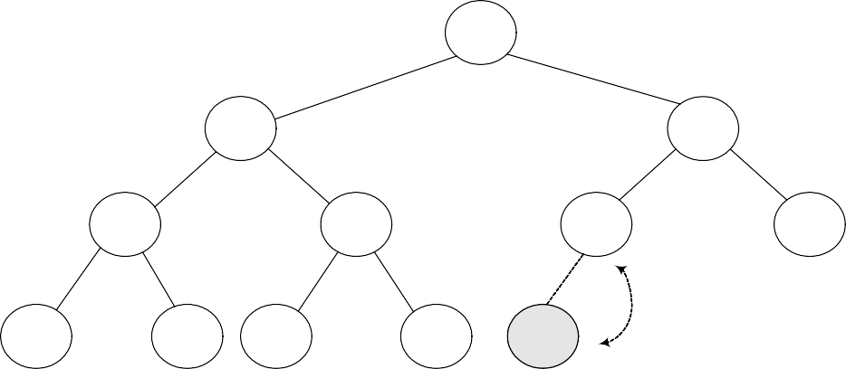
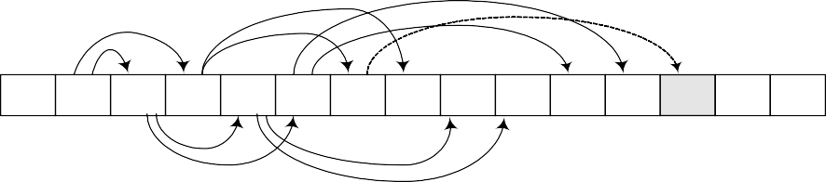
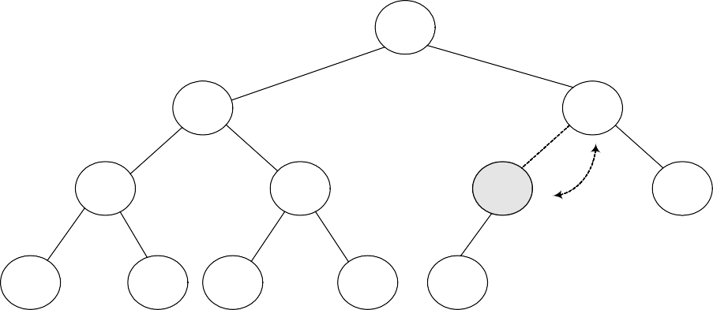
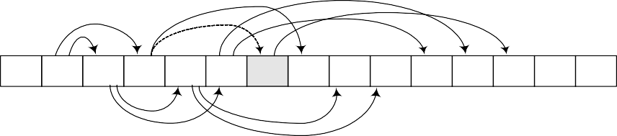
CS301 – Data Structures
Lecture No. 30
Insert (15) with exchange
1 13
2
14
3
16
4
24
5
21
6
19
7
68
8
65
9
26
10
32
11
31
12
15
0
13 14 16 24 21 19 68 65 26 32 31 15
1 2 3 4 5 6 7 8 9 10 11 12
13 14
Fig 30.1
The new element 15 is inserted at the last array position 12. Being a complete binary tree, the next new node will be the left child of node 19. As node 19 is at array position 6 (or level order traversal), its left child will be 6 * 2 = 12th position node or the value at 12th position in the array. Now, we see where we will have to carry out the exchange operation. As the parent of 15, the number 19 is greater than it, the first exchange will be among 19 and 15 as shown in the above figure. After exchange, the new figure is shown in Fig 30.2.
Insert (15)
with exchange
1 13
2
14
3
16
4
24
5
21
6
15
7
68
8
65
9
26
10
32
11
31
12
19
0
13 14 16 24 21
1 2 3 4 5
15 68 65 26 32 31 19
6 7 8 9 10 11 12 13 14
Fig 30.2
You can see that both the elements have exchanged positions i.e. 19 has come down and 15 gone up. But number 15 is still less than its parent 16, so we will have another exchange operation.

Slide 55
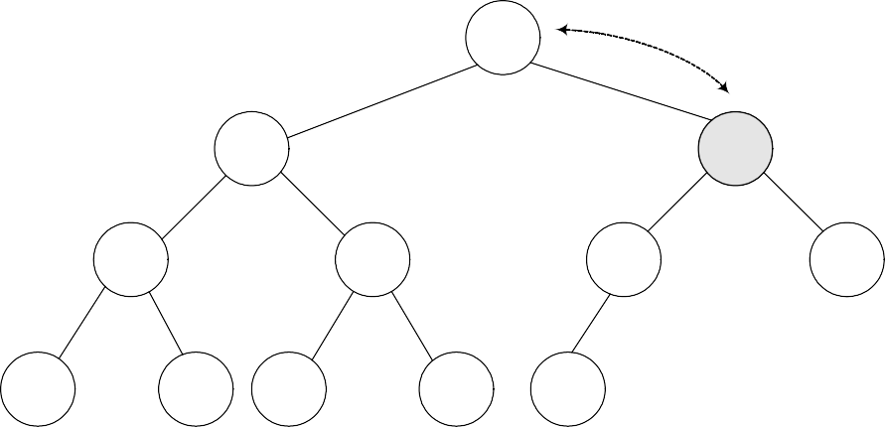
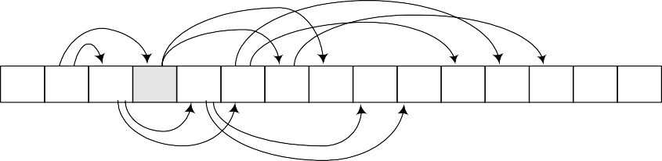
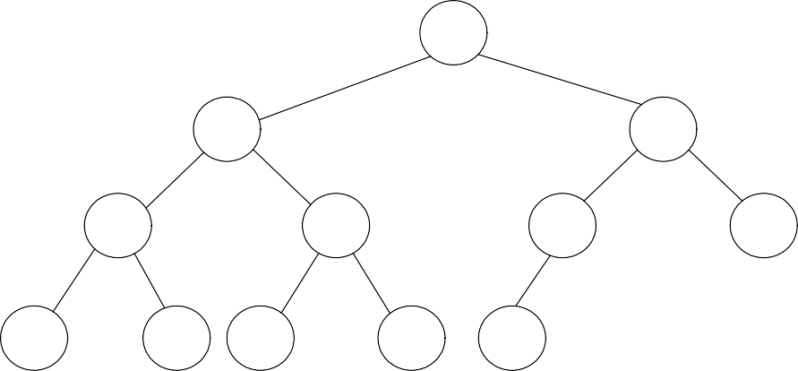
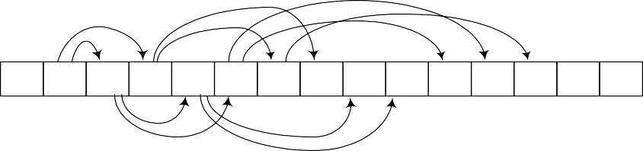
CS301 – Data Structures
Lecture No. 30
Insert (15) with exchange
1 13
2
14
3
15
4
24
5
21
6
16
7
68
8
65
9
26
10
32
11
31
12
19
0
13 14 15 24 21 16 68 65 26 32 31
1 2 3 4 5 6 7 8 9 10 11
19
12 13 14
Fig 30.3
Now the new parent of 15 is 13 which is less than it. Therefore, the exchange operation will stop here as 15 has found its destination in the tree. This new tree is not violating any condition of heap order as witnessed before insertion of 15. It has become min-heap again while maintaining its status as a complete binary tree.
Insert (15) with exchange
1 13
2
14
3
15
4
24
5
21
6
16
7
68
8
65
9
26
10
32
11
31
12
19
13 14 15 24 21 16 68 65 | 26 | 32 31 | 19
0 1 2 3 4 5 6 7 8 | 9 | 10 11 | 12 13 14
Fig 30.4
A view of the path shows that the number 15 has gone through to find its final destination in the tree. It has only affected the right sub-tree’s left branch that was containing 16, 19 and 15. It has not affected any other branch. This is not a binary search tree. Here we are only fulfilling one condition that the parent value should be

Slide 56
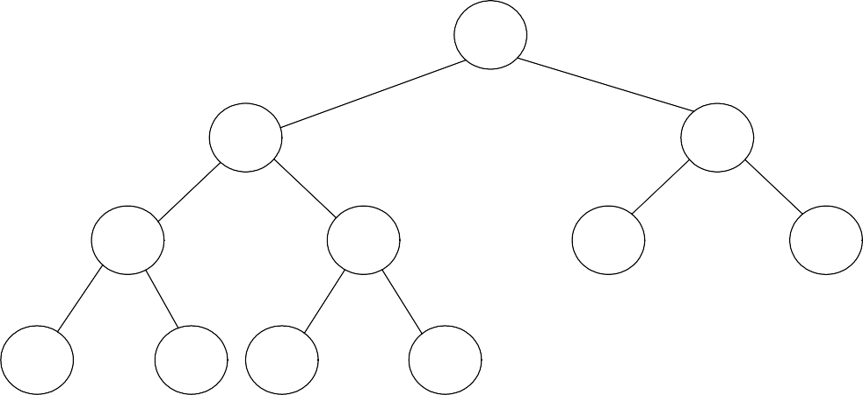
CS301 – Data Structures Lecture No. 30
less than that of its two-children. These exchanges will not take long as we did mathematically that a tree containing N nodes; can go to log₂N level maximum. You know, when we built binary tree for balancing, it had turned into a linked list. Here the case is different. the number of levels in complete binary tree will be around log₂N while building a complete binary tree.
Now, we should be clear that a new element can go up to what maximum level in the tree. If the number is greater than all parent nodes, it will be already at its destination
place, needing no exchange. If we insert a number smaller than all parent nodes, the exchange operation reaches to the root of the tree. But this exchange operation’s
intensity does not increase from the one we saw in our previous case of linked lists.
Deleting from a Min-Heap (deleteMin)
Now, we will see how the delete operation is executed in the heap. We do a lot of insert and delete (removal from the data structure) operations especially when heap is used in the priority queue. Normally the delete operation is a bit complex. However, in this case, it is quite easy-to-do.
We want to write a function deleteMin(), which will find and delete the minimum number from the tree.
Finding the minimum is easy; it is at the top of the heap.
See the heap below. It is a min-heap. Now the question arises where the minimum number will be lying. It is clear from the definition of min-heap that it should be in the root of the tree. So finding the minimum is very easy.
1 13
2
14
3
16
4
24
5
21
6
19
7
68
8
65
9
26
10
32
11
31
Fig 30.5
To understand it better, consider the tree form first, instead of thinking about the array. Remember, we have implemented the complete binary tree with the help of an array for the sake of efficiency. It is not necessary to implement it this way. We can also implement it with pointers. However, heap is normally implemented through array.
Coming back to the deletion, it is necessary to understand that
Deletion (or removal) causes a hole which needs to be filled.

Slide 57
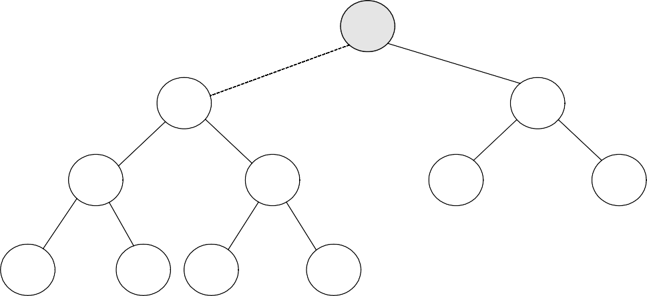
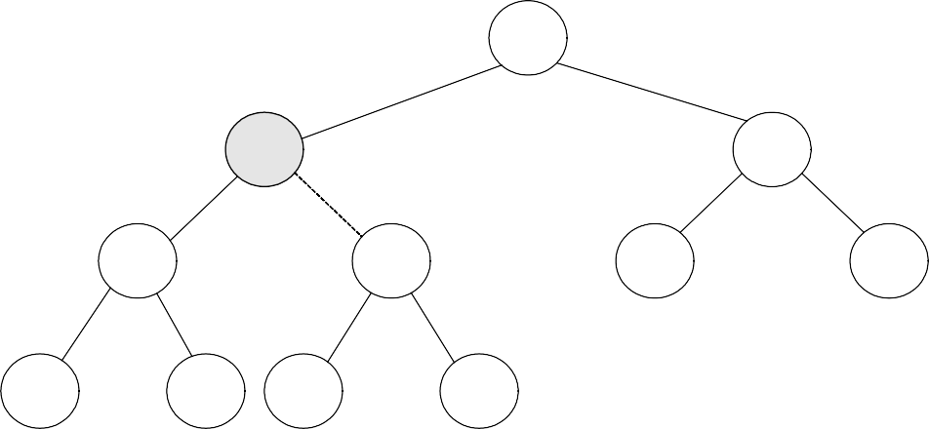
CS301 – Data Structures
Lecture No. 30
deleteMin()
1
2
14
3
16
4
24
5
21
6
19
7
68
8
65
9
26
10
32
11
31
Fig 30.6
In the above figure, we have deleted the root node, resulting in a hole at the root position. To maintain it as a complete binary tree, we have to fill this hole. Now, we will identify the appropriate candidates to fill this hole. As the parent is the minimum as compared to its right and left children, the appropriate candidates are both right and left children of the root node. Both children will be compared and the smaller one will take the vacant place. In the above figure, the children 14 and 16 are candidates for the vacant position. Being the minimum, 14 will be put in the hole.
deleteMin()
1 14
2
3
16
4
24
5
21
6
19
7
68
8
65
9
26
10
32
11
31
Fig 30.7
In the Fig 30.7, we can see that the 14 has been placed at the root position. However, the vacuum at the previous position of 14 has created a hole. To fill this hole, the same logic is applied i.e. we compare both right and left children of the hole and let the minimum take over the place. Here 24 and 21 are compared. Being the smaller one, 21 is placed at the vacant position. This way we get the latest figure of the tree as seen in the following figure. (Fig 30.8.)

Slide 58
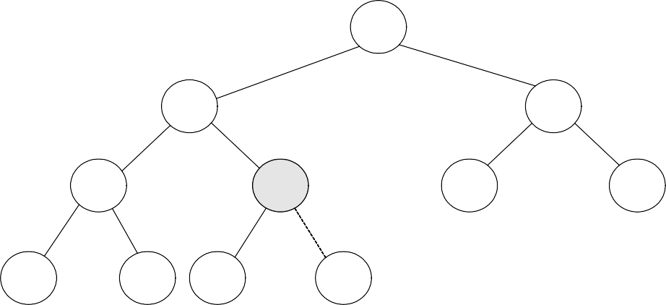
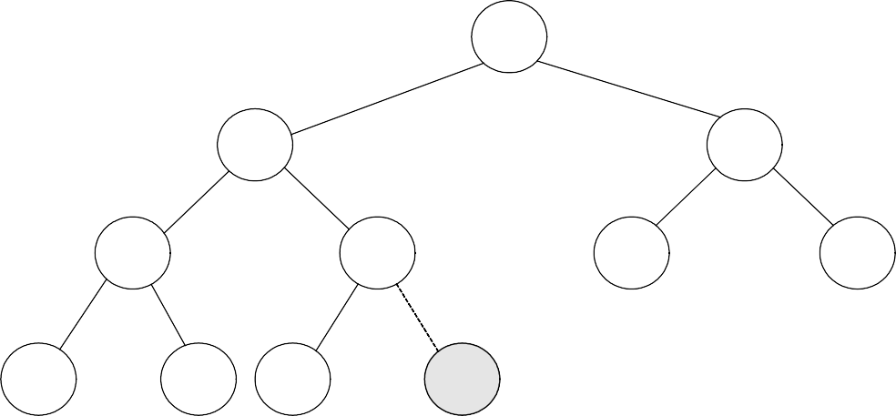
CS301 – Data Structures
Lecture No. 30
deleteMin()
1 14
2
21
3
16
4
24
5
6
19
7
68
8
65
9
26
10
32
11
31
Fig 30.8
The hole is now created at previous position of 21. This time, the children- 32 and 31 are compared and being smaller, 31 takes over the place and the tree becomes as shown in the figure Fig 30.9.
deleteMin()
1
14
2
21
3
16
4
24
5
31
6
19
7
68
8
65
9
26
10
32
11
Fig 30.9
The hole has been transferred from top to the bottom. It has reached at such a position where it can be deleted.

Slide 59
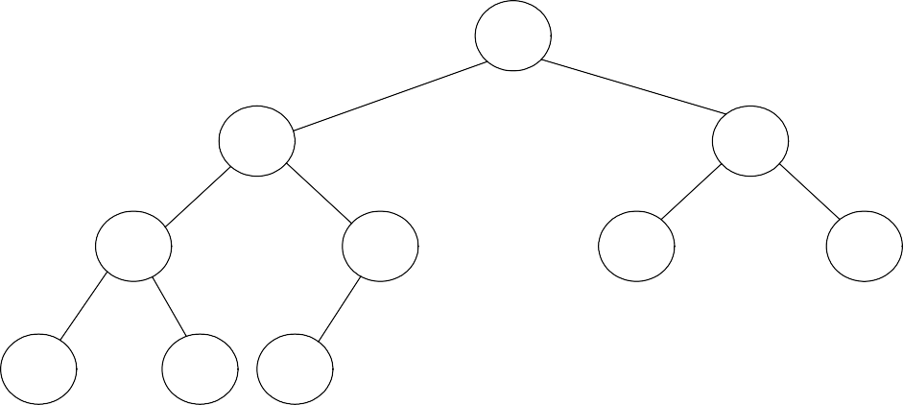
CS301 – Data Structures
Lecture No. 30
deleteMin(): heap size is reduced by 1
1
14
2
21
3
16
4
24
5
31
6
19
7
68
8
65
9
26
10
32
Fig 30.10
While using array to store complete binary tree, we can free array element at the end. From the above figure Fig 30.10, the last array index 11 is no more there and the node has been deleted.
We saw that the data element was inserted at the bottom of the tree and moved upwards while comparing it with the parents (following the i/2 scheme) until its
destination was found. Similarly, when we deleted a node, the hole was produced. While following the definition of min-heap, the hole kept on moving from top to the bottom (following the 2i or 2i+1 scheme).

Slide 60
CS301 – Data Structures Lecture No. 30
Building a Heap (buildHeap)
Now, we will see how a heap can be made and in which peculiar conditions, it should be built. We may have the data (for example, numbers) on hand, needed to used to construct the tree .These data elements may be acquired one by one to construct the tree. A programmer may face either the situations. If we consider priority queue, it is normally empty initially. Events are inserted in the queue as these are received. You can also consider priority queue in another application where data can be inserted into the queue or taken out at one time.
Let’s say we have a large unsorted list of names and want to sort it. This list can be sorted with the help of the heap sort algorithm. When we l construct the heap or
complete binary tree of the list, the smallest name (considering alphabet ‘a’ as the smallest) in the list will take the root node place in the tree. The remaining names will
take their places in the nodes below the root node according to their order. Remember, we are not constructing binary search tree but a min-heap to sort the data. After the construction of the min-heap from all the names in the list, we start taking
the elements out (deleting) from the heap in order to retrieve the sorted data. The first element that is taken out would be the smallest name in the heap. The remaining heap after taking out the deleted node will be reduced by one element in size and the next
name will be at the root position. It is taken out to further reduce the tree size by one. This way, the continuation of the process of taking out the elements from the heap
will ultimately lead to a situation when there is no more node left in the tree.
While keeping in view the time consumption factor, can we find a better way than this? We may change the data structure or algorithm for that. There are data structures which are more efficient than heap. But at the moment, we are focusing the heap data structure. We will see, what we can do algorithmically to improve the performance, having all the data simultaneously to construct the tree.
Following are some of the important facts about building a heap.
Suppose we are given as input N keys (or items) to build a heap of the keys.
Obviously, this can be done with N successive inserts.
Each call to insert will either take unit time (leaf node) or log₂N (if new key
percolates all the way up to the root).
The worst time for building a heap of N keys could be Nlog₂N.
It turns out that we can build a heap in linear time.
Suppose we have a method percolateDown(p) that moves down the key in node p
downwards.
This is what happens in deleteMin.We have used the word keys in the first point. This is the same concept as that of the database keys, used to identify information uniquely. Using the example of telephone directory (also discussed in a number of previous lectures), we see that it contains the person name (first, middle and last), address (street address, district and postal code) and telephone number. All these information together form a data record. This set of information fields (record) will always be together. The key item here can be the unique name of the person or the telephone number.
Consider that we have N number of items i.e. names. One way is to call insert for
every element one by one. For N elements, it will be N number of calls obviously. Being an iterative process, this insertion technique can be executed in a loop fashion. Let’s talk about the time taken to insert a node in the tree. It depends on the value to be inserted and the values already present in the tree. The number of exchanges can be variable. Therefore, the insertion time is also variable. Each call will be a unit time (in

Slide 61
CS301 – Data Structures Lecture No. 30
case of leaf node) or log₂N (if new key percolates all the way up to the root node). For the whole tree, the worst time for N keys would be Nlog₂N.
Next point tells about the possibility of reducing the time from Nlog₂N and it can turn out to be a linear time. This is our target and we want to achieve it. Let’s talk about the ways to achieve the linear time.
The word percolate above means something is going upward from downward. This
terminology is coming from coffee maker, where the hot water moves upwards. This phenomenon happens at the time of insertion. On the contrary, in delete operation, the hole moves towards the bottom of the tree. You must be remembering that we discussed about insertion in the heap without making exchanges and by finding the destination position first before making any change. Similarly in case of deletion, the hole moves downward while the data moves upwards. Let’s write a method for the delete operation percolateDown(p). This method will find which child of the hole will be moved upwards and the movement of hole to the bottom of the tree.
We will see, using this method, how can we built a heap that will be take lesser time than Nlog₂N.
Initial data (N = 15)
 | 65 | 31 | 32 | 26 | 21 | 19 | 68 | 13 | 24 | 15 | 14 | 16 | 5 | 70 | 12
0
1
2
3
4 5
Fig 30.11
6
7
8
9 10 11
12 13 14 15
As shown in the figure Fig 30.11, we are given a list of 15 elements and asked to
construct a heap of them. The numbers are stored in an array, starting from index (position) 1. This start of array from position 1 is to make the tree construction easier. It will be clear in a moment. Contrary to the previous situation when array was used to store heap or complete binary tree, we should now think what would be the picture of complete binary tree out of it. It may seem complex. But actually it is quite easy. You start from the very first element in the array i.e. the root of the tree. The children of root are present at 2i and 2i+1, which in this case, are at positions 2(1) = 2 and 2(1)+1=3. The children nodes for the node at position 2 are at positions 2(2)=4 and 2(2)+1=5. Similarly, the children nodes for the node at position 3 are at positions 6 and 7. Apply this logic to the whole of this array and try to construct a tree yourself. You should build a tree as given in the figure Fig 30.12.

Slide 62
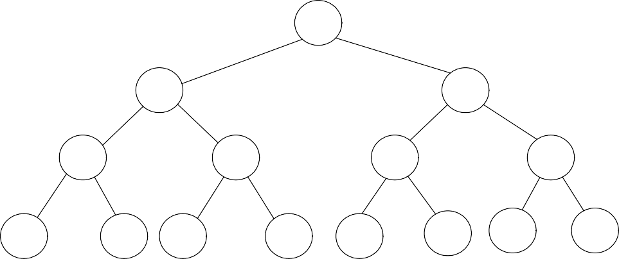
CS301 – Data Structures
Lecture No. 30
Initial data (N = 15)
1
65
2
31
3
32
4
26
5
21
6
19
7
68
8
13
9
24
10
15
11
14
12
16
13
5
14
70
15
12
 | 65 | 31 | 32 | 26 | 21 | 19 | 68 | 13 | 24 | 15 | 14 | 16 | 5 | 70 | 12
0
1
2
3
4
5
6
7 8
9
10 11 12 13 14 15
Fig 30.12
Is this tree binary one? Yes, every node has only two left and right children.
Is it a complete binary tree? It surely is as there is no node that has missing left or right child.
The next question is; is it a min-heap. By looking at the root node and its children, as
the root node is containing 65 and the children nodes are containing 31 and 32, you can abruptly say that no, it is not a min-heap.
How can we make min-heap out of it? We may look for percolateDown(p).method to
convert it into a min-heap. As discussed above, the percolateDown(p).moves the node with value p down to its destination in the min-heap tree orders. The destination of a node, can be its next level or maximum the bottom of the tree (the leaf node). The node will come down to its true position (destination) as per min-heap order and other nodes (the other data) will be automatically moving in the upward direction.
The general algorithm is to place the N keys in an array and consider it to be an unordered binary tree.
The following algorithm will build a heap out of N keys. for( i = N/2; i > 0; i-- )
percolateDown(i);
A close look on the above loop shows that it is starts from N/2 position and goes down to 0. The loop will be terminated, once the position 0 is reached. Inside, this loop is a single function call percolateDown(i). We will try to understand this loop using figures.

Slide 63
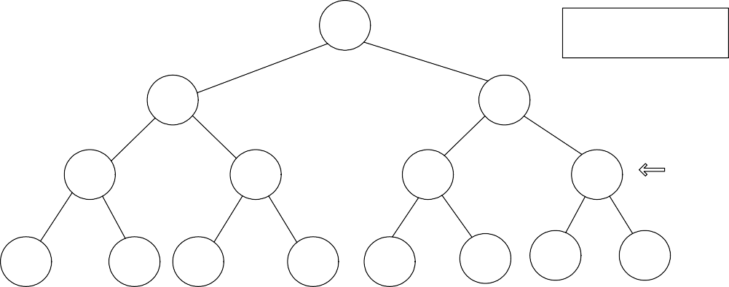
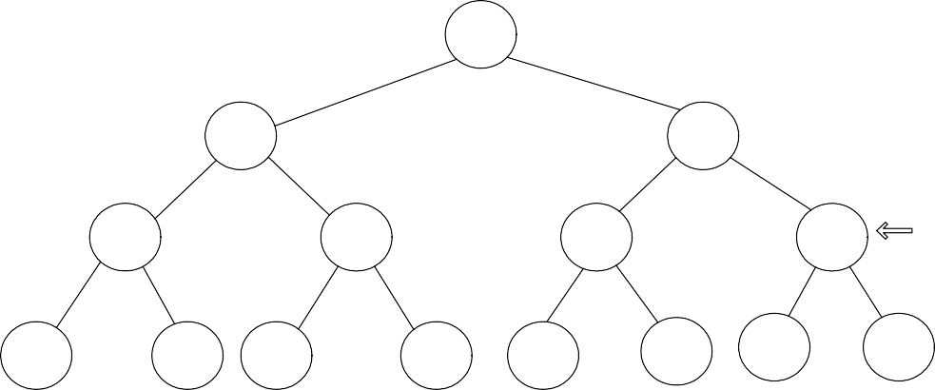
CS301 – Data Structures
Lecture No. 30
i = 15/2 = 7
1 65
Why i = n/2?
2
31
3
32
4
26
5
21
6
19
7
68
i
8
13
9
24
10
15
11
14
12
16
13
5
14
70
15
12
i
 | 65 | 31 | 32 | 26 | 21 | 19 | 68 | 13 | 24 | 15 | 14 | 16 | 5 | 70 | 12
0 1
2 3 4 5 6 7 8 9 10 11
12 13 14 15
Fig 30.13
You can see the top left of the figure Fig 30.13. It is given i = 15/2 = 7. This is the initial value of i .The value in the array at position 7 is 68. In our discussion, we will interchangeably discuss array and binary tree. The facts arising in the discussion would be applicable to both. Considering this position 7, we will try to build min-heap below that. We know that for position 7, we have children at positions 2(7)=14 and 2(7)+1=15. So as children of the number 68 (which is the value at position 7), we have 70 and 12. After applying the percolateDown(i), we get the tree as shown in Fig 30.14.
i = 15/2 = 7
1 65
2
31
3
32
4
26
5
21
6
19
7
12
i
8
13
9
24
10
15
11
14
12
16
13
5
14
70
15
68
i
 | 65 | 31 | 32 | 26 | 21 | 19 | 12 | 13 | 24 | 15 | 14 | 16 | 5 | 70 | 68
0
1
2
3
4
5
6
7 8
9 10 11
12 13 14 15
Fig 30.14
You can see in the figure that 12 has moved upward and 68 has gone down. Now, what about this little tree starting from 12 and below it is min-heap. Surely, it is.
Next, we go for second iteration in the loop, the value of i is decremented and it
becomes 6.

Slide 64
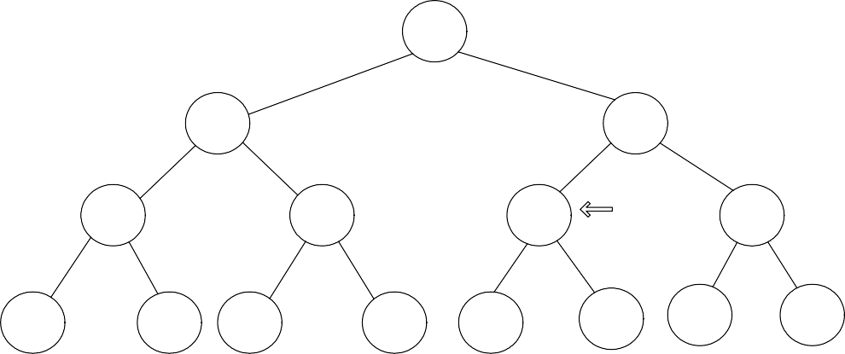
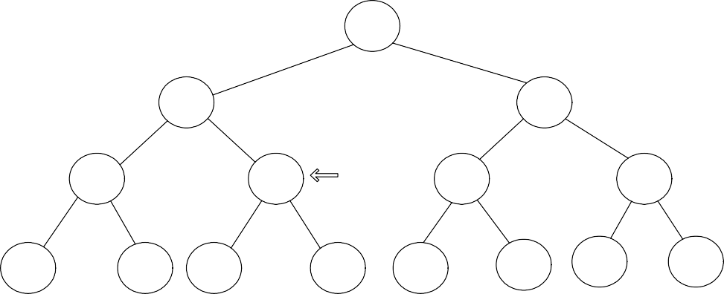
CS301 – Data Structures
Lecture No. 30
1 65
2
31
3
32
4
26
5
21
6
19
i
7
12
8
13
9
24
10
15
11
14
12
16
13
5
14
70
15
68
i
 | 65 | 31 | 32 | 26 | 21 | 19 | 12 | 13 | 24 | 15 | 14 | 16 | 5 | 70 | 68
0
1
2
3
4
5
6 7 8
9 10 11
12 13 14 15
Fig 30.15
The node at position 6 is 19. Here the method percolateDown(i) is applied and we get the latest tree as shown in Fig 30.16.
i = 5
1 65
2
31
3
32
4
26
5
21
i
6
5
7
12
8
13
9
24
10
15
11
14
12
16
13
19
14
70
15
68
i
 | 65 | 31 | 32 | 26 | 21 | 5 | 12 | 13 | 24 | 15 | 14 | 16 | 19 | 70 | 68
0
1
2
3
4
5
6
7 8
9 10 11
12 13 14 15
Fig 30.16
The node 5 has come upward while the node 19 has moved downward. Its value of has decremented. It is now ready for next iteration. If we see the positions of i in the tree, we can see that it is traveling in one level of the tree, which is the second last level.
The question might have already arisen in your minds that why did we start i by N/2 instead of N. You think about it and try to find the answer. The answer will be given in the next lecture. We will continue with this example in the next lecture. You are strongly encouraged to complete it yourself before the next lecture.

